Slide 1
A Data-Driven Approach to Cardiovascular Disease Prediction: Comparing Machine Learning Algorithms.
A Capstone Project
Submitted by
Sneha Shivanna
Under the guidance of
Dr. Ertunga Ozelkan

Slide 2
Introduction
Cardiovascular diseases (CVDs) are among the leading causes of mortality worldwide, emphasizing the critical need for early diagnosis and prevention. This project explores a data-driven approach to CVD prediction by integrating supervised machine learning models, such as Logistic Regression, k-Nearest Neighbors, Support Vector Machines, Decision Trees, and Random Forest with clinical data from the Cleveland dataset. Through structured data preprocessing, normalization, and feature engineering, the study aims to enhance prediction accuracy and model reliability. By applying principles of engineering management alongside predictive analytics, this capstone bridges the gap between technical model development and its real-world applicability in healthcare environments, ultimately contributing to better diagnostic decision-making.

Slide 3
Project Scope
Aim: To apply supervised ML techniques for early and accurate CVD prediction.
Integrates feature engineering with model training using real-world clinical data.
Applies engineering management principles to optimize ML workflows.
Tools used: Python, Scikit-learn, visualization libraries.
Focus on bridging technical performance with operational healthcare efficiency.

Slide 4
Machine Learning Models
01
05
K-NN
Random Forest
02
Logistic Regression
03
SVM
04
Decision Trees

Slide 5
K-NN
K-NN is a supervised learning algorithm used for classification and regression.
It finds the 'K' closest data points to classify new instances based on majority voting.
It requires efficient distance calculations for accurate predictions.
Social networks

Slide 6
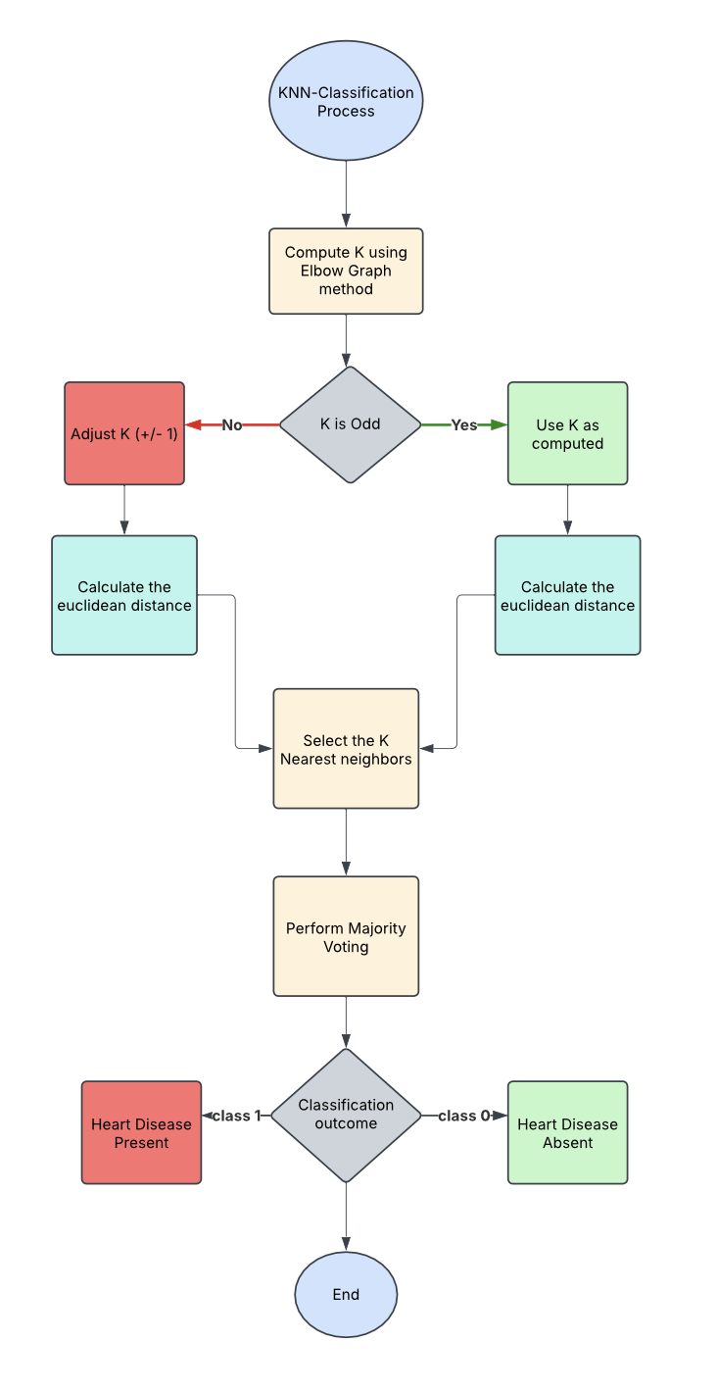
Flow Chart

Slide 7
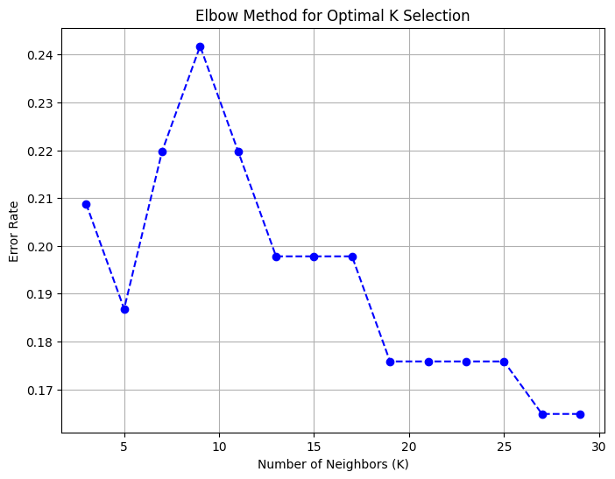
K-NN Implementation
Step 1 - Selecting the Optimal Value of K.
Elbow Method Graph
Observations:
Train K-NN models for K values from 3 to 30.
Empirical Rule: 303/10=30.3303 / 10 = 30.3303/10=30.3 suggests maximum K = 30.
Plot Error Rate vs. K.
Find Elbow Point → Where error rate stabilizes.

Slide 8
K-NN Implementation
Step 1 - Selecting the Optimal Value of K.
Observation: K = 3 to 11: Sharp increase in error → Underfitting.
K = 11 to 17: No major improvement.
K = 17 to 21: Significant drop (Better model).
K > 23: Error stabilizes (No further improvement).
Conclusion: Optimal K = 19, 21, or 23.

Slide 9
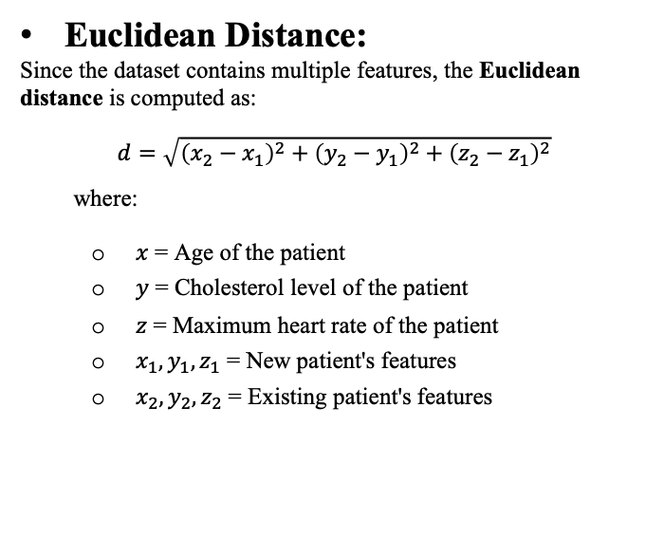
K-NN Implementation
Step 2 - Calculating the Distance
Euclidean Distance:
Since the dataset contains multiple features, the Euclidean distance is computed as:
$$d=\sqrt{{\left(x_{2}−x_{1}\right)}^{2}+{\left(y_{2}−y_{1}\right)}^{2}+{\left(z_{2}−z_{1}\right)}^{2}}$$
where:
$x$ = Age of the patient
$y$ = Cholesterol level of the patient
$z$ = Maximum heart rate of the patient
$x_{1},y_{1},z_{1}$ = New patient's features
$x_{2},y_{2},z_{2}$ = Existing patient's features

Slide 10
K-NN Implementation
Example:
Index | Age | CP | Chol
0 | 63 | 1 | 233
1 | 67 | 4 | 286
2 | 67 | 4 | 229
3 | 37 | 3 | 250
4 | 41 | 2 | 204
New (X) | 45 | 3 | 220
Normalized Data:
Index | Age (Z-score) | CP (Z-score) | Chol (Z-score) | Target
0 | 0.63 | -1.38 | -0.24 | 0
1 | 0.94 | 0.92 | 1.50 | 1
2 | 0.94 | 0.92 | -0.38 | 1
3 | -1.42 | 0.15 | 0.32 | 0
4 | -1.10 | -0.62 | -1.20 | 0
New (X) | -0.79 | 0.15 | -0.67 | 1

Slide 11
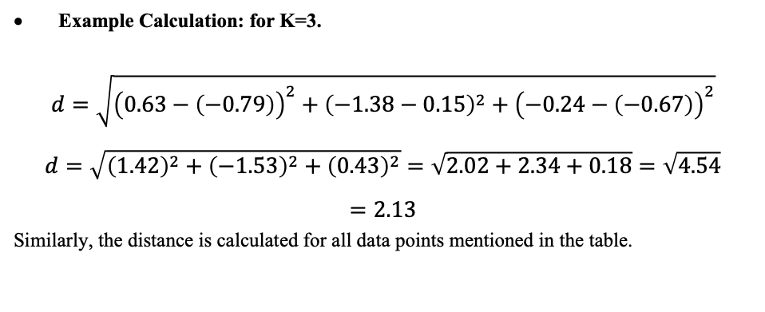
K-NN Implementation
Example:
Example Calculation: for K=3.
$$d=\sqrt{{\left(0.63−\left(−0.79\right)\right)}^{2}+{\left(−1.38−0.15\right)}^{2}+{\left(−0.24−\left(−0.67\right)\right)}^{2}}$$
$$d=\sqrt{{\left(1.42\right)}^{2}+{\left(−1.53\right)}^{2}+{\left(0.43\right)}^{2}}=\sqrt{2.02+2.34+0.18}=\sqrt{4.54}=2.13$$
Similarly, the distance is calculated for all data points mentioned in the table.

Slide 12
K-NN Implementation
Example:
Result:
Identified 3 nearest neighbors:
Index | Distance to New Patient
4 | 0.98
3 | 1.17
2 | 1.91

Slide 13
K-NN Implementation
Final Classification
Final Classification
Index | Target (heart disease?)
4 | 0 (No)
3 | 0 (No)
2 | 1 (Yes)

Slide 14
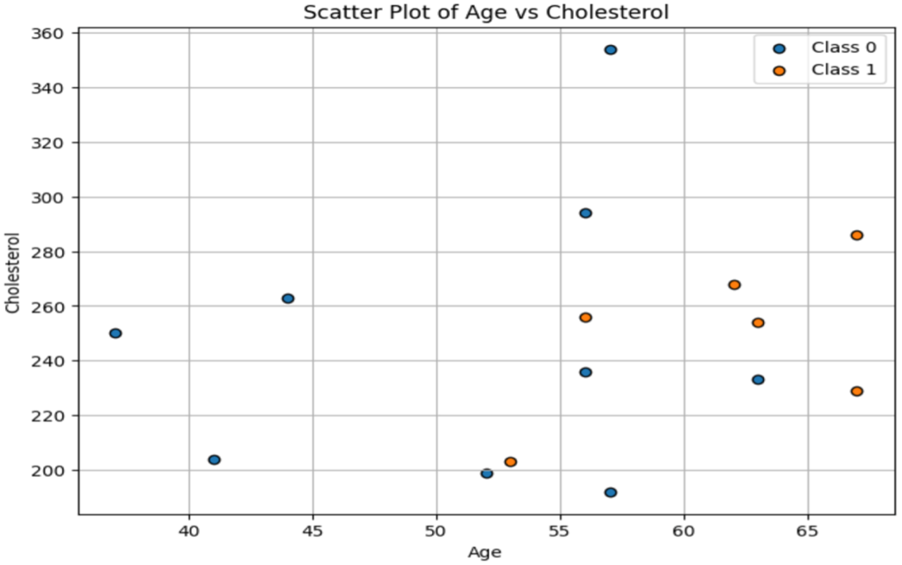
K-NN Implementation
Graphical Illustration

Slide 15
Result Discussion
Classification Report
Class | Precision | Recall | F1-Score
0 | 80% | 87% | 84%
1 | 85% | 77% | 81%
Accuracy | 82% | 82% | 82%
Accuracy: 0.82 (or 82.00%)

Slide 16
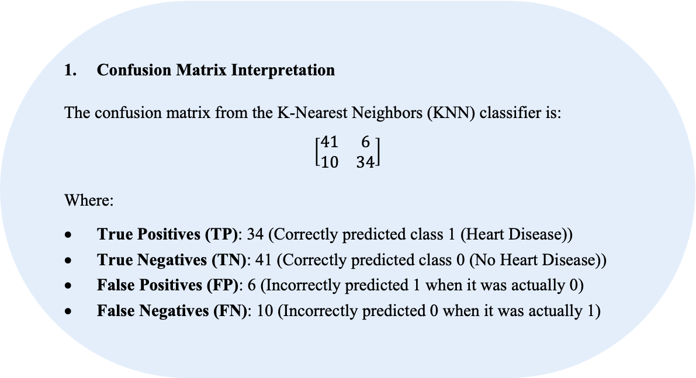
Result Discussion
Confusion Matrix Interpretation
The confusion matrix from the K-Nearest Neighbors (KNN) classifier is:
$$\left[\begin{matrix}41 & 6 \\ 10 & 34\end{matrix}\right]$$
Where:
True Positives (TP): 34 (Correctly predicted class 1 (Heart Disease))
True Negatives (TN): 41 (Correctly predicted class 0 (No Heart Disease))
False Positives (FP): 6 (Incorrectly predicted 1 when it was actually 0)
False Negatives (FN): 10 (Incorrectly predicted 0 when it was actually 1)

Slide 17
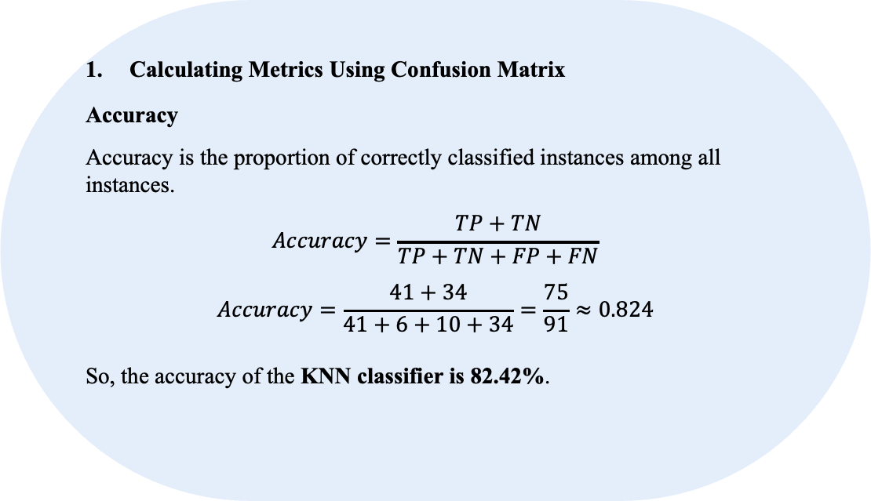
Result Discussion
Calculating Metrics Using Confusion Matrix
Accuracy
Accuracy is the proportion of correctly classified instances among all instances.
$$Accuracy=\frac{TP+TN}{TP+TN+FP+FN}$$
$$Accuracy=\frac{41+34}{41+6+10+34}=\frac{75}{91}≈0.824$$
So, the accuracy of the KNN classifier is 82.42%.

Slide 18
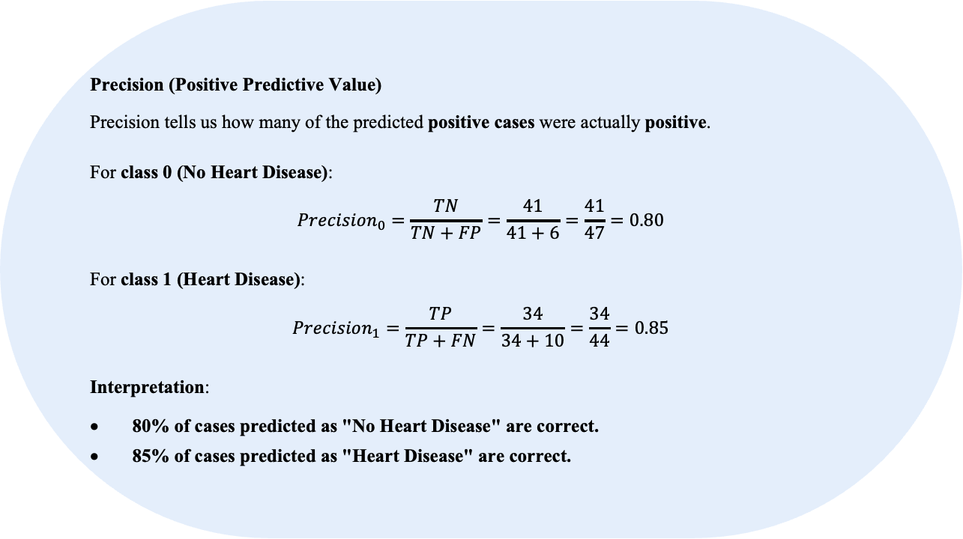
Result Discussion
Precision (Positive Predictive Value)
Precision tells us how many of the predicted positive cases were actually positive.
For class 0 (No Heart Disease):
$$Precision_{0}=\frac{TN}{TN+FP}=\frac{41}{41+6}=\frac{41}{47}=0.80$$
For class 1 (Heart Disease):
$$Precision_{1}=\frac{TP}{TP+FN}=\frac{34}{34+10}=\frac{34}{44}=0.85$$
Interpretation:
80% of cases predicted as "No Heart Disease" are correct.
85% of cases predicted as "Heart Disease" are correct.

Slide 19
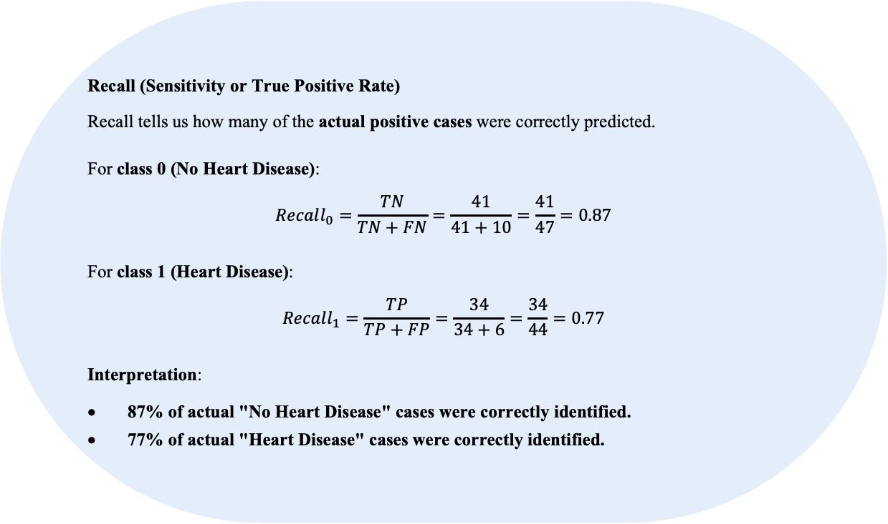
Result Discussion
Recall (Sensitivity or True Positive Rate)
Recall tells us how many of the actual positive cases were correctly predicted.
For class 0 (No Heart Disease):
$$Recall_{0}=\frac{TN}{TN+FN}=\frac{41}{41+10}=\frac{41}{47}=0.87$$
For class 1 (Heart Disease):
$$Recall_{1}=\frac{TP}{TP+FP}=\frac{34}{34+6}=\frac{34}{44}=0.77$$
Interpretation:
87% of actual "No Heart Disease" cases were correctly identified.
77% of actual "Heart Disease" cases were correctly identified.

Slide 20
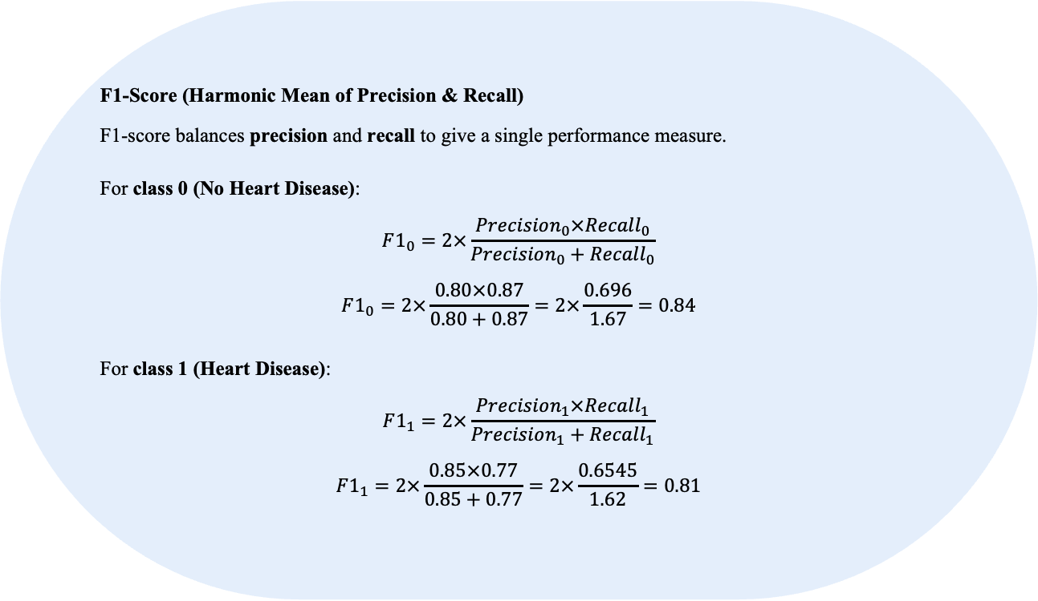
Result Discussion
F1-Score (Harmonic Mean of Precision & Recall)
F1-score balances precision and recall to give a single performance measure.
For class 0 (No Heart Disease):
$$F1_{0}=2×\frac{Precision_{0}×Recall_{0}}{Precision_{0}+Recall_{0}}$$
$$F1_{0}=2×\frac{0.80×0.87}{0.80+0.87}=2×\frac{0.696}{1.67}=0.84$$
For class 1 (Heart Disease):
$$F1_{1}=2×\frac{Precision_{1}×Recall_{1}}{Precision_{1}+Recall_{1}}$$
$$F1_{1}=2×\frac{0.85×0.77}{0.85+0.77}=2×\frac{0.6545}{1.62}=0.81$$

Slide 21
Result Discussion
Final Interpretation
The KNN model achieved 82% accuracy
Precision is higher for class 1 (Heart Disease), meaning fewer false positives.
Recall is higher for class 0 (No Heart Disease), meaning fewer false negatives.
F1-scores indicate a balanced performance between both classes.

Slide 22
Logistic Regression
A statistical model used for binary classification.
Estimates the probability that a given input belongs to a category.
Uses the sigmoid function to map inputs to probabilities between 0 and 1
Optimized using Maximum Likelihood Estimation (MLE)
Social networks

Slide 23
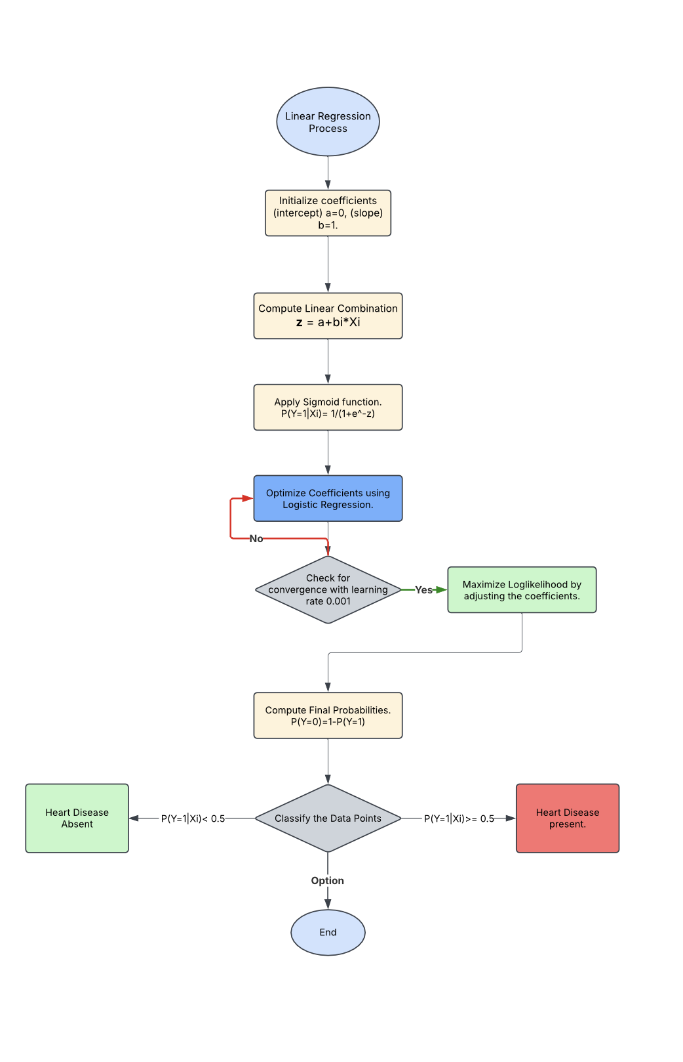
Logistic Regression Implementation
Flowchart

Slide 24
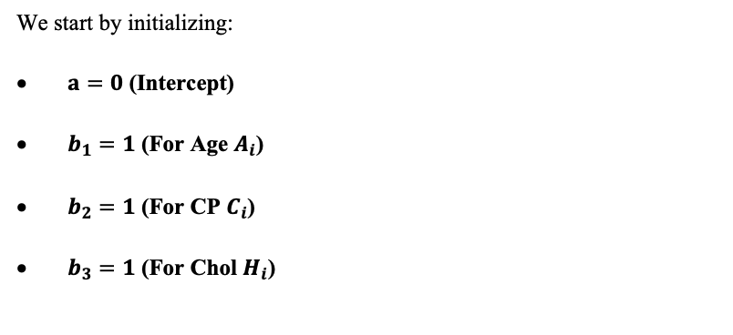
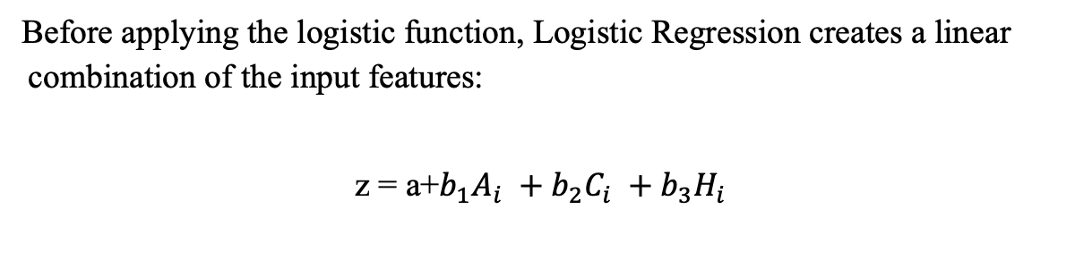
Logistic Regression Implementation
Logistic Regression Hypothesis.
Before applying the logistic function, Logistic Regression creates a linear combination of the input features:
z = a+$b_{1}A_{i} +b_{2}C_{i} +b_{3}H_{i}$
We start by initializing:
$a=0$ (Intercept)
$b_{1}=1$ (For Age $A_{i}$)
$b_{2}=1$ (For CP $C_{i}$)
$b_{3}=1$ (For Chol $H_{i}$)

Slide 25
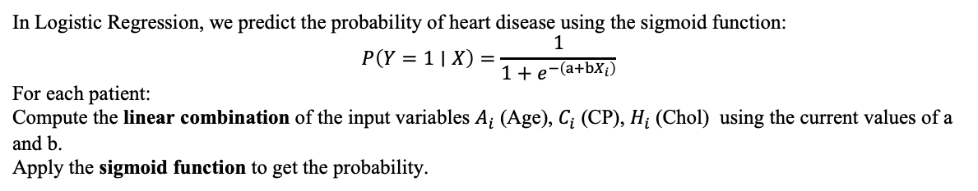
Logistic Regression Implementation
Logistic Regression Hypothesis.
In Logistic Regression, we predict the probability of heart disease using the sigmoid function:
$$P\left(Y=1∣X\right)=\frac{1}{1+e^{−\left(a+bX_{i}\right)}}$$
For each patient:
Compute the linear combination of the input variables $A_{i}$ (Age), $C_{i}$ (CP), $H_{i}$ (Chol) using the current values of a and b.
Apply the sigmoid function to get the probability.

Slide 26
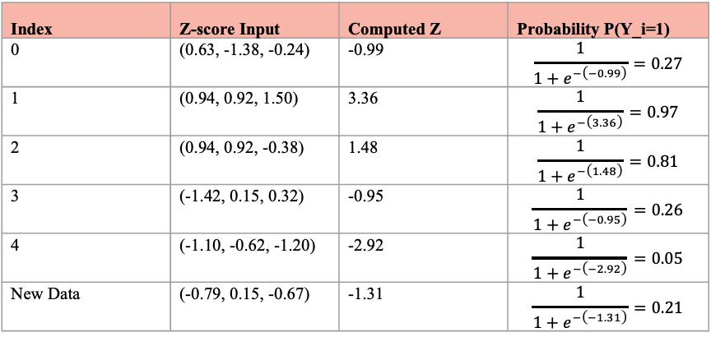
Logistic Regression Implementation
Example Using the data
z = a+$b_{1}A_{i} +b_{2}C_{i} +b_{3}H_{i}$.
Index | Z-score Input | Computed Z | Probability P(Y_i=1)
0 | (0.63, -1.38, -0.24) | -0.99 | $$\frac{1}{1+e^{−\left(−0.99\right)}}=0.27$$
1 | (0.94, 0.92, 1.50) | 3.36 | $$\frac{1}{1+e^{−\left(3.36\right)}}=0.97$$
2 | (0.94, 0.92, -0.38) | 1.48 | $$\frac{1}{1+e^{−\left(1.48\right)}}=0.81$$
3 | (-1.42, 0.15, 0.32) | -0.95 | $$\frac{1}{1+e^{−\left(−0.95\right)}}=0.26$$
4 | (-1.10, -0.62, -1.20) | -2.92 | $$\frac{1}{1+e^{−\left(−2.92\right)}}=0.05$$
New Data | (-0.79, 0.15, -0.67) | -1.31 | $$\frac{1}{1+e^{−\left(−1.31\right)}}=0.21$$

Slide 27
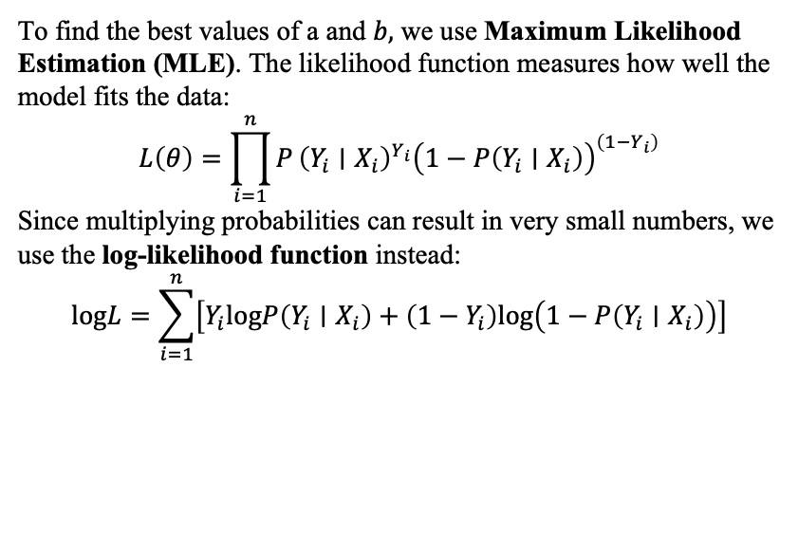
Logistic Regression Implementation
Compute the Log-Likelihood Function
To find the best values of a and $b,$ we use Maximum Likelihood Estimation (MLE). The likelihood function measures how well the model fits the data:
$$L\left(θ\right)=\prod_{i=1}^{n}{P}{\left(Y_{i}∣X_{i}\right)}^{Y_{i}}{\left(1−P\left(Y_{i}∣X_{i}\right)\right)}^{\left(1−Y_{i}\right)}$$
Since multiplying probabilities can result in very small numbers, we use the log-likelihood function instead:
$$logL=\sum_{i=1}^{n}{\left[Y_{i}logP\left(Y_{i}∣X_{i}\right)+\left(1−Y_{i}\right)log\left(1−P\left(Y_{i}∣X_{i}\right)\right)\right]}$$

Slide 28
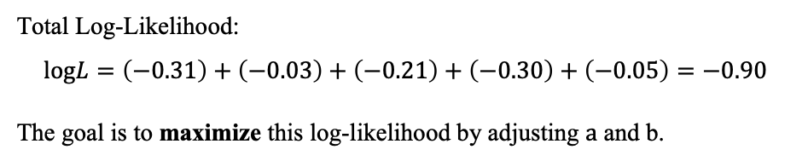
Logistic Regression Implementation
Example Calculation
Index | Heart Disease (Y_i) | Computed Probability | Log-Likelihood Contribution
0 | 0 | 0.27 | -0.31
1 | 1 | 0.97 | -0.03
2 | 1 | 0.81 | -0.21
3 | 0 | 0.26 | -0.3
4 | 0 | 0.05 | -0.05
Total Log-Likelihood:
$$logL=\left(−0.31\right)+\left(−0.03\right)+\left(−0.21\right)+\left(−0.30\right)+\left(−0.05\right)=−0.90$$
The goal is to maximize this log-likelihood by adjusting $a$ and b.

Slide 29
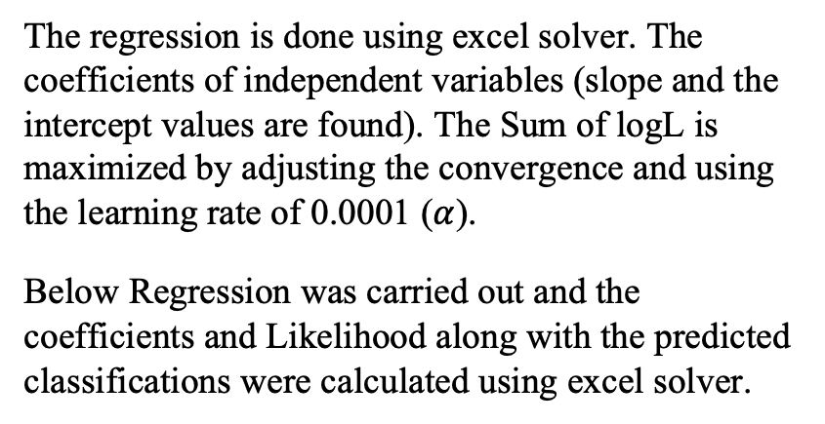
Logistic Regression Implementation
Update the Coefficients Using Regression
The regression is done using excel solver. The coefficients of independent variables (slope and the intercept values are found). The Sum of logL is maximized by adjusting the convergence and using the learning rate of 0.0001 ($α$).
Below Regression was carried out and the coefficients and Likelihood along with the predicted classifications were calculated using excel solver.

Slide 30
Logistic Regression Implementation
Excel File for Regression for the original dataset (303).

Slide 31
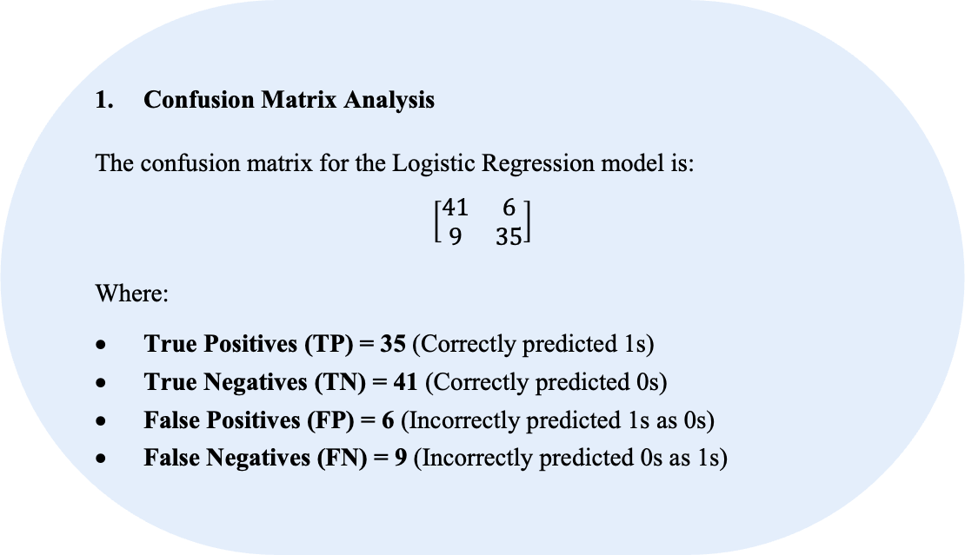
Result Discussion
Confusion Matrix Analysis
The confusion matrix for the Logistic Regression model is:
$$\left[\begin{matrix}41 & 6 \\ 9 & 35\end{matrix}\right]$$
Where:
True Positives (TP) = 35 (Correctly predicted 1s)
True Negatives (TN) = 41 (Correctly predicted 0s)
False Positives (FP) = 6 (Incorrectly predicted 1s as 0s)
False Negatives (FN) = 9 (Incorrectly predicted 0s as 1s)

Slide 32
Result Discussion
Classification Report
Class | Precision | Recall | F1-Score
0 | 82% | 87% | 85%
1 | 85% | 80% | 82%
Accuracy | 84% | 84% | 84%
Accuracy: 0.84 = 84%

Slide 33
SUPPORT VECTOR MACHINE
A statistical model used for binary classification.
Finds the optimal hyperplane that best separates different classes
Works well for high-dimensional spaces and non-linearly separable data
Social networks

Slide 34
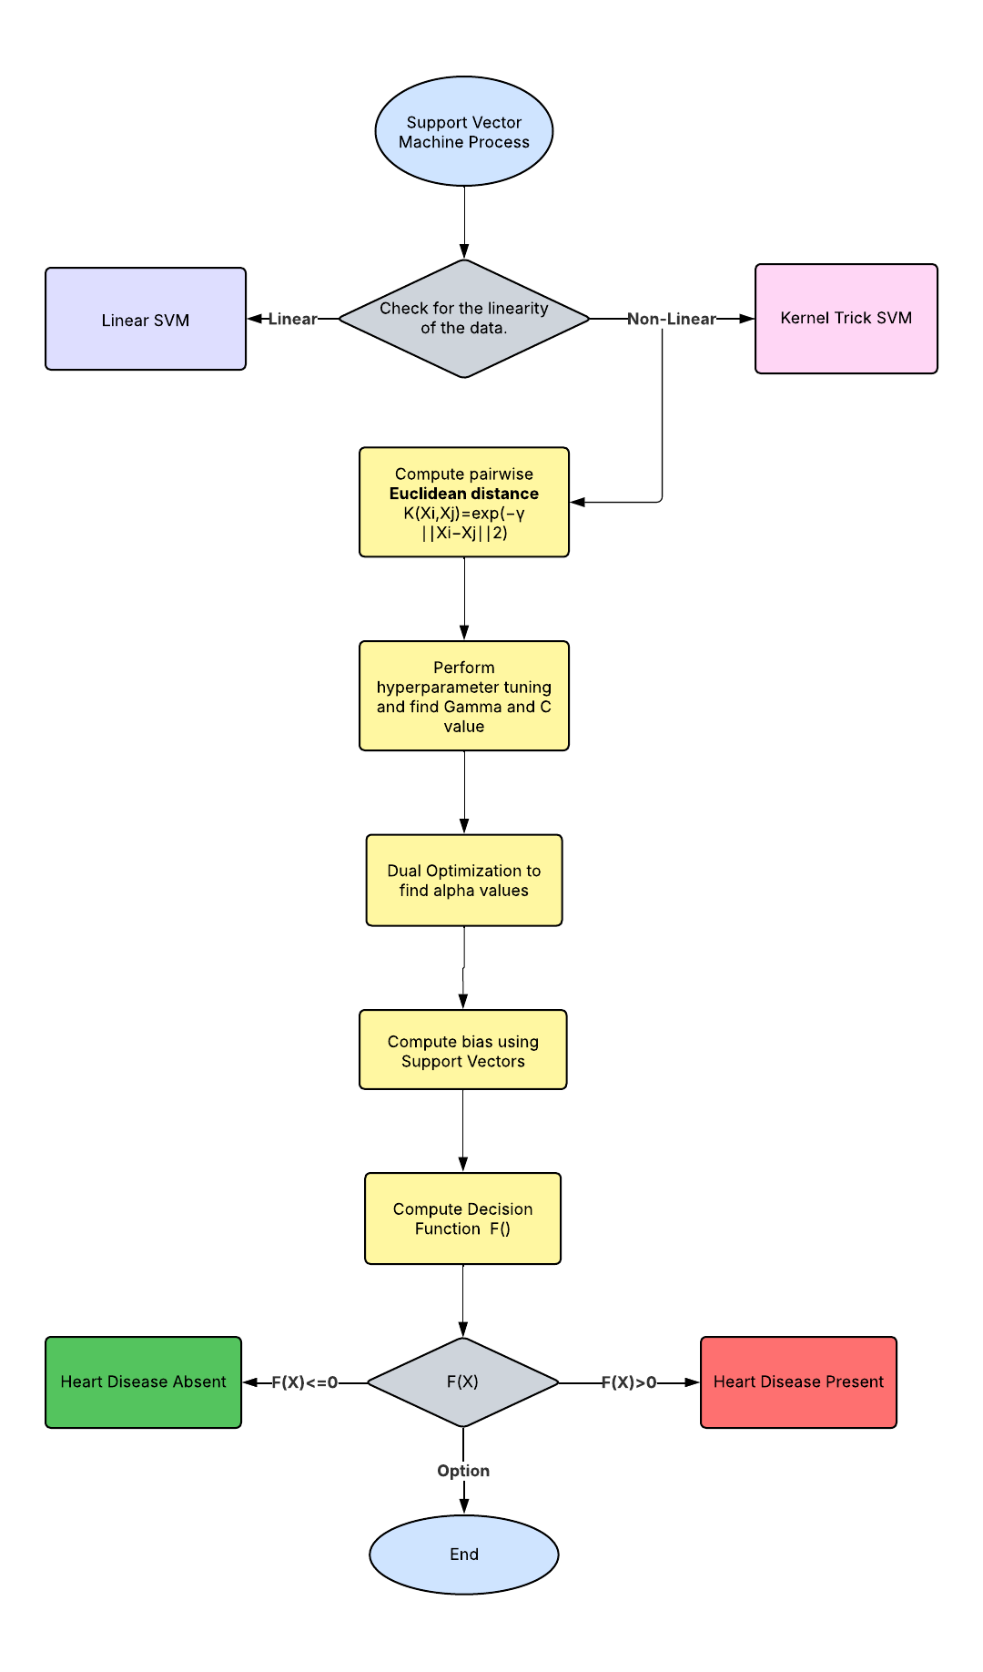
Flow Chart

Slide 35
SVM Implementation
Types of SVM
Linear SVM: Used when data is linearly separable.
Non-Linear SVM: Uses the kernel trick to separate non-linearly separable data.
Example: Radial Basis Function (RBF) Kernel.

Slide 36
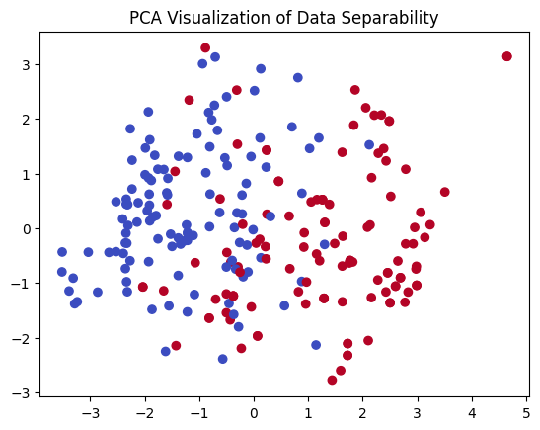
SVM Implementation
Since our dataset is not linearly separable, as observed in the PCA visualization, we employ a Non-Linear SVM with an RBF kernel.
Principal Component Analysis (PCA) Visualization is a technique used to reduce the dimensionality of a dataset and visualize it in 2D or 3D while preserving as much variance (information) as possible.

Slide 37
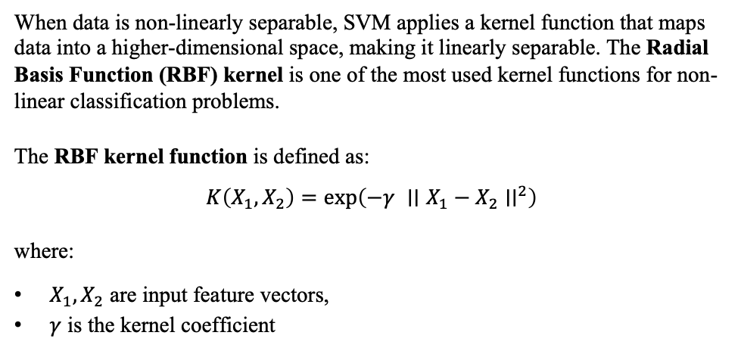
SVM Implementation
Kernel Trick and RBF Kernel
When data is non-linearly separable, SVM applies a kernel function that maps data into a higher-dimensional space, making it linearly separable. The Radial Basis Function (RBF) kernel is one of the most used kernel functions for non-linear classification problems.
The RBF kernel function is defined as:
$$K\left(X_{1},X_{2}\right)=exp\left(−γ ∣∣X_{1}−X_{2}∣∣^{2}\right)$$
where:
$X_{1},X_{2}$ are input feature vectors,
$γ$ is the kernel coefficient

Slide 38
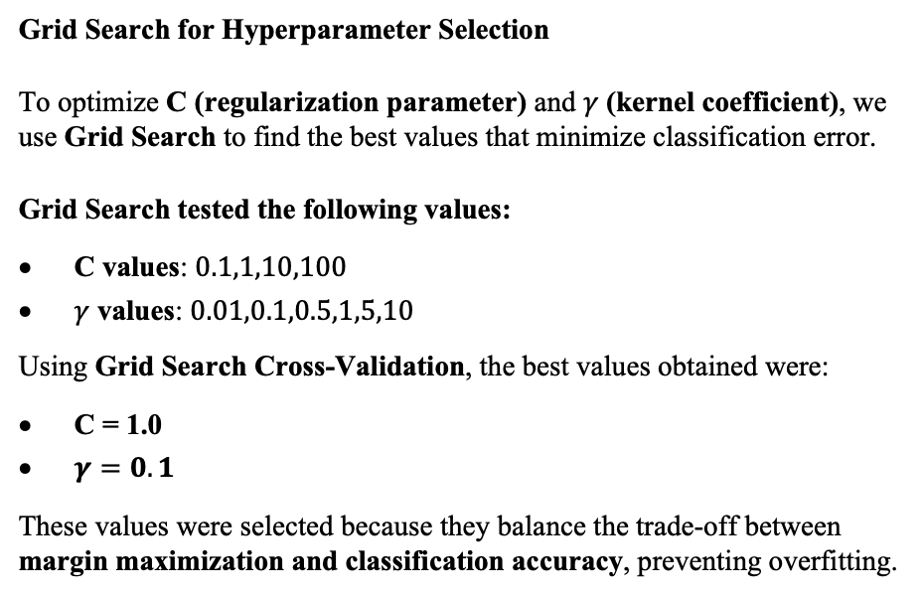
SVM Implementation
Grid Search & Hyperparameter Tuning
Grid Search for Hyperparameter Selection
To optimize C (regularization parameter) and $γ$ (kernel coefficient), we use Grid Search to find the best values that minimize classification error.
Grid Search tested the following values:
C values: $0.1,1,10,100$
$γ$ values: $0.01,0.1,0.5,1,5,10$
Using Grid Search Cross-Validation, the best values obtained were:
C = 1.0
$γ=0.1$
These values were selected because they balance the trade-off between margin maximization and classification accuracy, preventing overfitting.

Slide 39
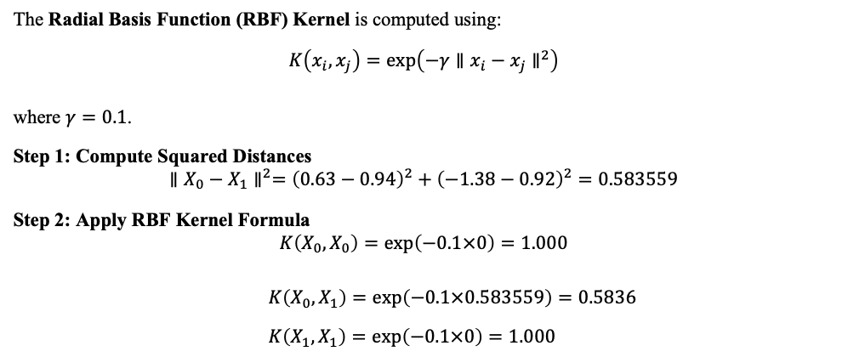
SVM Implementation
Example
Index | Age (Z-score) | CP (Z-score) | Chol (Z-score)
0 | 0.63 | -1.38 | -0.24
1 | 0.94 | 0.92 | 1.50
The Radial Basis Function (RBF) Kernel is computed using:
$$K\left(x_{i},x_{j}\right)=exp\left(−γ∥x_{i}−x_{j}∥^{2}\right)$$
where $γ=0.1$.
Step 1: Compute Squared Distances
$$∥X_{0}−X_{1}∥^{2}={\left(0.63−0.94\right)}^{2}+{\left(−1.38−0.92\right)}^{2}=0.583559$$
Step 2: Apply RBF Kernel Formula
$$K\left(X_{0},X_{0}\right)=exp\left(−0.1×0\right)=1.000$$
$K\left(X_{0},X_{1}\right)=exp\left(−0.1×0.583559\right)=0.5836$
$K\left(X_{1},X_{1}\right)=exp\left(−0.1×0\right)=1.000$

Slide 40
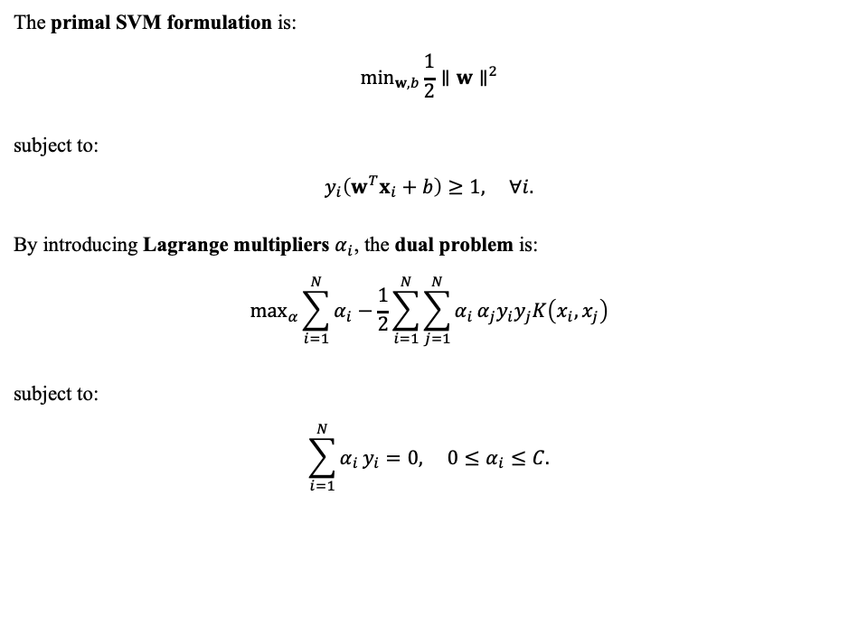
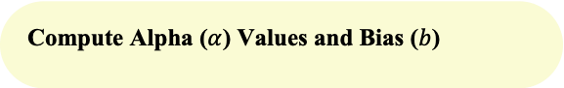
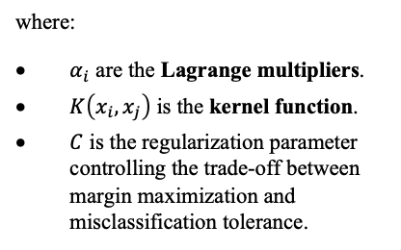
SVM Implementation
Compute Alpha ($α$) Values and Bias ($b$)
The primal SVM formulation is:
$$\min_{w,b}\frac{1}{2}∥w∥^{2}$$
subject to:
$$y_{i}\left(w^{T}x_{i}+b\right)≥1, ∀i.$$
By introducing Lagrange multipliers $α_{i}$, the dual problem is:
$$\max_{α}\sum_{i=1}^{N}{α_{i}}−\frac{1}{2}\sum_{i=1}^{N}{\sum_{j=1}^{N}{α_{i}}}α_{j}y_{i}y_{j}K\left(x_{i},x_{j}\right)$$
subject to:
$$\sum_{i=1}^{N}{α_{i}}y_{i}=0, 0≤α_{i}≤C.$$
where:
$α_{i}$ are the Lagrange multipliers.
$K\left(x_{i},x_{j}\right)$ is the kernel function.
$C$ is the regularization parameter controlling the trade-off between margin maximization and misclassification tolerance.

Slide 41
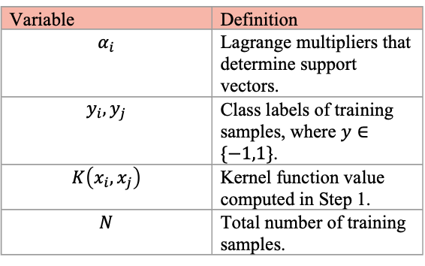
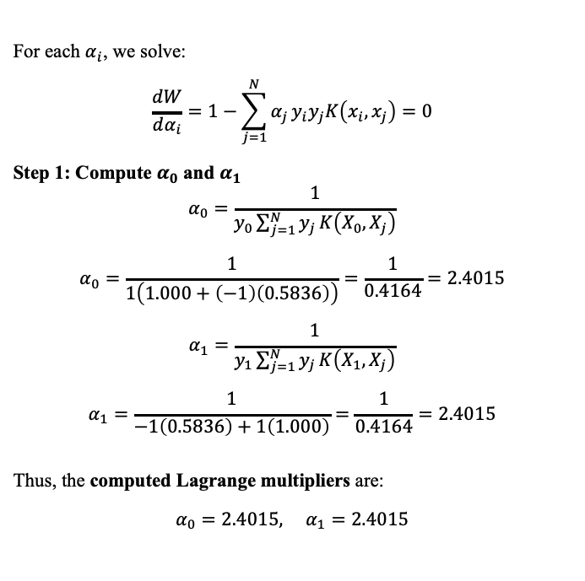
SVM Implementation
For each $α_{i}$, we solve:
$$\frac{dW}{dα_{i}}=1−\sum_{j=1}^{N}{α_{j}}y_{i}y_{j}K\left(x_{i},x_{j}\right)=0$$
Step 1: Compute $α_{0}$ and $α_{1}$
$$α_{0}=\frac{1}{y_{0}\sum_{j=1}^{N}{y_{j}}K\left(X_{0},X_{j}\right)}$$
$$α_{0}=\frac{1}{1\left(1.000+\left(−1\right)\left(0.5836\right)\right)}=\frac{1}{0.4164}=2.4015$$
$$α_{1}=\frac{1}{y_{1}\sum_{j=1}^{N}{y_{j}}K\left(X_{1},X_{j}\right)}$$
$$α_{1}=\frac{1}{−1\left(0.5836\right)+1\left(1.000\right)}=\frac{1}{0.4164}=2.4015$$
Thus, the computed Lagrange multipliers are:
$$α_{0}=2.4015, α_{1}=2.4015$$
Variable | Definition
$$α_{i}$$ | Lagrange multipliers that determine support vectors.
$$y_{i},y_{j}$$ | Class labels of training samples, where $y∈\{−1,1\}$.
$$K\left(x_{i},x_{j}\right)$$ | Kernel function value computed in Step 1.
$$N$$ | Total number of training samples.

Slide 42
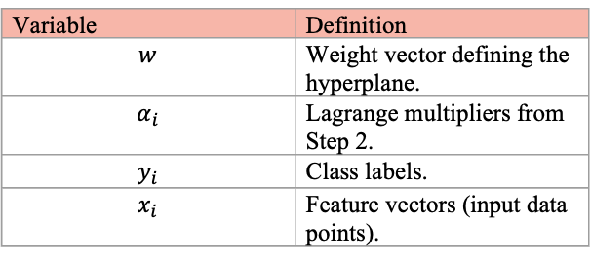
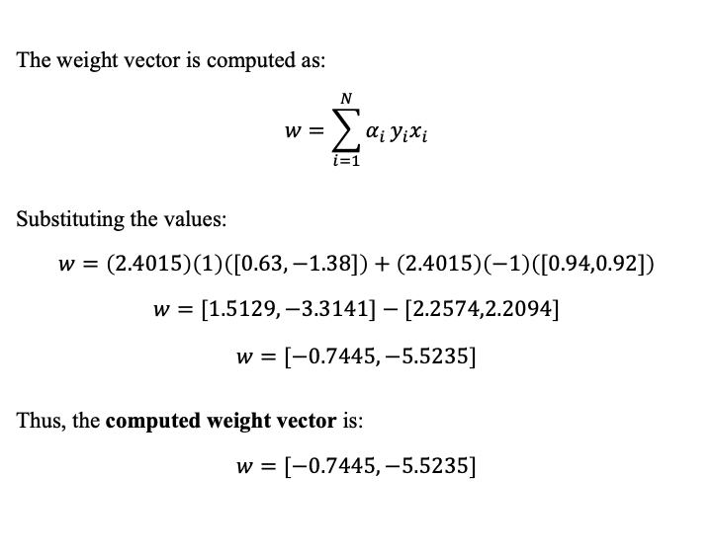
SVM Implementation
The weight vector is computed as:
$$w=\sum_{i=1}^{N}{α_{i}}y_{i}x_{i}$$
Substituting the values:
$$w=\left(2.4015\right)\left(1\right)\left([0.63,−1.38]\right)+\left(2.4015\right)\left(−1\right)\left([0.94,0.92]\right)$$
$$w=[1.5129,−3.3141]−[2.2574,2.2094]$$
$$w=[−0.7445,−5.5235]$$
Thus, the computed weight vector is:
$$w=[−0.7445,−5.5235]$$
Variable | Definition
$$w$$ | Weight vector defining the hyperplane.
$$α_{i}$$ | Lagrange multipliers from Step 2.
$$y_{i}$$ | Class labels.
$$x_{i}$$ | Feature vectors (input data points).

Slide 43
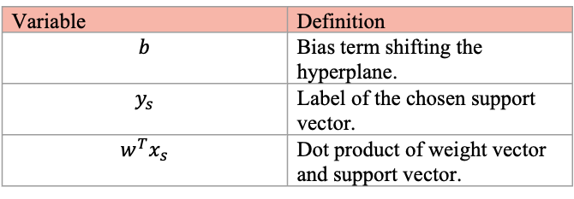
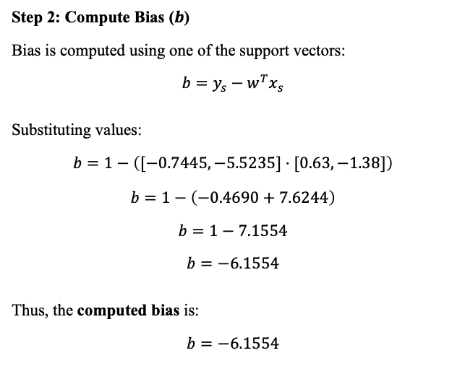
SVM Implementation
Step 2: Compute Bias ($b$)
Bias is computed using one of the support vectors:
$$b=y_{s}−w^{T}x_{s}$$
Substituting values:
$$b=1−\left([−0.7445,−5.5235]⋅[0.63,−1.38]\right)$$
$$b=1−\left(−0.4690+7.6244\right)$$
$$b=1−7.1554$$
$$b=−6.1554$$
Thus, the computed bias is:
$$b=−6.1554$$
Variable | Definition
$$b$$ | Bias term shifting the hyperplane.
$$y_{s}$$ | Label of the chosen support vector.
$$w^{T}x_{s}$$ | Dot product of weight vector and support vector.

Slide 44
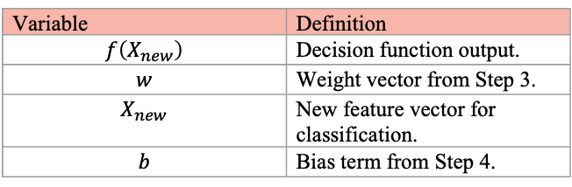
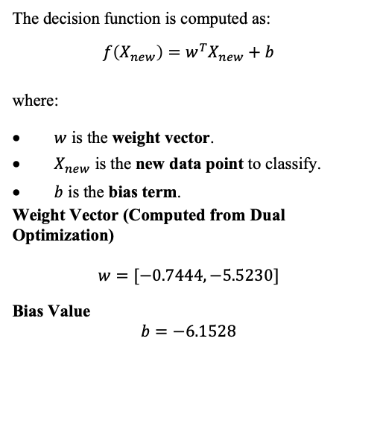
SVM Implementation
Compute Decision Function and Prediction
The decision function is computed as:
$$f\left(X_{new}\right)=w^{T}X_{new}+b$$
where:
$w$ is the weight vector.
$X_{new}$ is the new data point to classify.
$b$ is the bias term.
Weight Vector (Computed from Dual Optimization)
$$w=[−0.7444,−5.5230]$$
Bias Value
$$b=−6.1528$$
Variable | Definition
$$f\left(X_{new}\right)$$ | Decision function output.
$$w$$ | Weight vector from Step 3.
$$X_{new}$$ | New feature vector for classification.
$$b$$ | Bias term from Step 4.

Slide 45
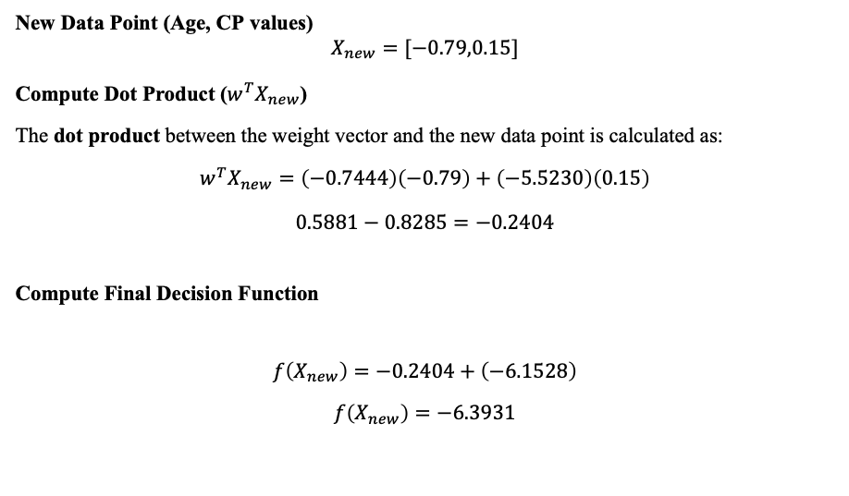
SVM Implementation
Compute Decision Function and Prediction
New Data Point (Age, CP values)
$$X_{new}=[−0.79,0.15]$$
Compute Dot Product ($w^{T}X_{new}$)
The dot product between the weight vector and the new data point is calculated as:
$$w^{T}X_{new}=\left(−0.7444\right)\left(−0.79\right)+\left(−5.5230\right)\left(0.15\right)$$
$$0.5881−0.8285=−0.2404$$
Compute Final Decision Function
$$f\left(X_{new}\right)=−0.2404+\left(−6.1528\right)$$
$$f\left(X_{new}\right)=−6.3931$$

Slide 46
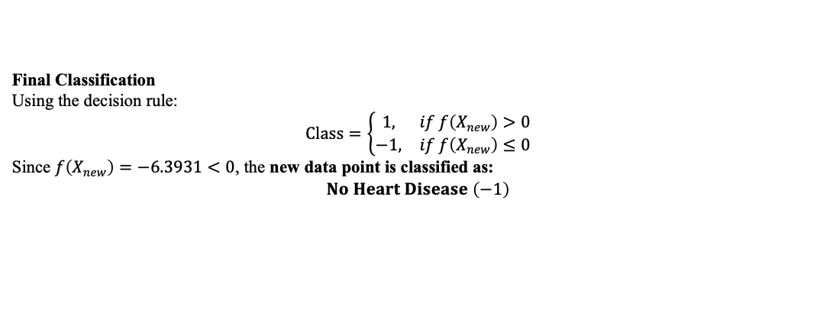
SVM Implementation
Final Classification
Using the decision rule:
$$Class=\left\{\begin{matrix}1, & if f\left(X_{new}\right)>0 \\ −1, & if f\left(X_{new}\right)≤0\end{matrix}\right.$$
Since $f\left(X_{new}\right)=−6.3931<0$, the new data point is classified as:
$$No Heart Disease \left(−1\right)$$

Slide 47
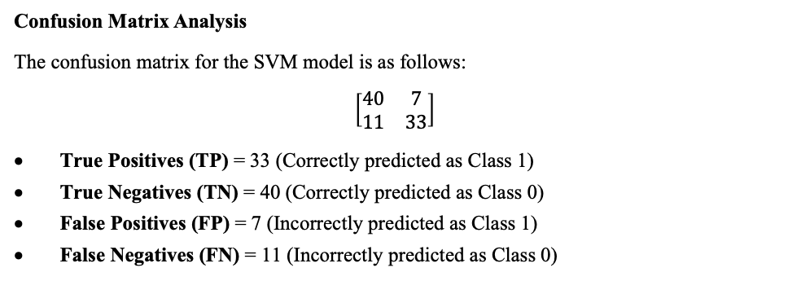
Result Discussion
Confusion Matrix Analysis
The confusion matrix for the SVM model is as follows:
$$\left[\begin{matrix}40 & 7 \\ 11 & 33\end{matrix}\right]$$
True Positives (TP) = 33 (Correctly predicted as Class 1)
True Negatives (TN) = 40 (Correctly predicted as Class 0)
False Positives (FP) = 7 (Incorrectly predicted as Class 1)
False Negatives (FN) = 11 (Incorrectly predicted as Class 0)

Slide 48
Result Discussion
Classification Report
Class | Precision | Recall | F1-Score
0 | 78% | 85% | 82%
1 | 82% | 75% | 79%
Accuracy | 80% | 80% | 80%
Accuracy: 80 %

Slide 49
Decision Tree Algorithm
A statistical model used for binary classification.
Models decisions and their possible consequences in a tree-like structure
Each internal node represents a decision or test on a feature
Each branch represents the outcome of that decision.
Each leaf node represents a class label (in classification) or a value (in regression).
Social networks

Slide 50
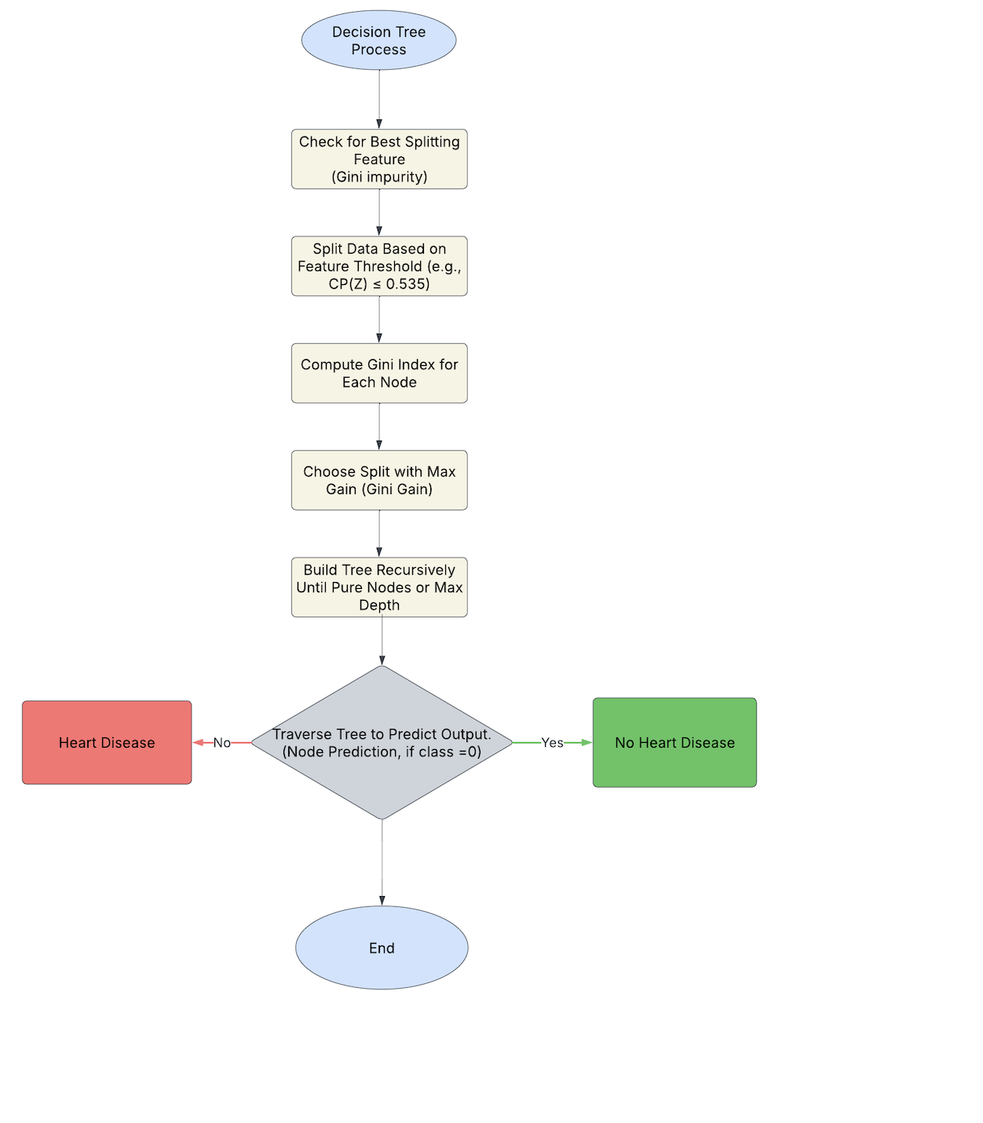
Flow Chart
Flow Chart

Slide 51
Decision Tree Implementation
The algorithm works by recursively splitting the dataset based on feature values that best separate the target classes, using metrics such as:
Gini Impurity
Information Gain (Entropy)

Slide 52
Decision Tree Implementation
Gini Impurity and Node Splits
Gini impurity measures the probability of misclassification in a node. At each node, the feature and threshold that provide the highest Gini gain (impurity reduction) are selected for splitting. The root node in our case splits based on CP (Z) ≤ 0.535.
The Gini impurity for a node is given by the formula:
Gini = 1 - Σ (pᵢ)², where pᵢ is the proportion of class i in the node.

Slide 53
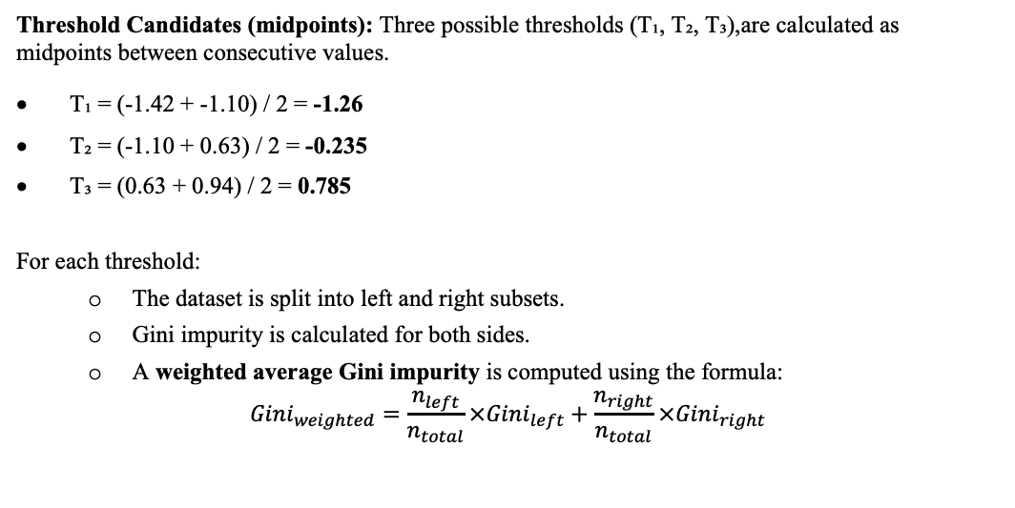
Decision Tree Implementation
Sorted Age (Z): The data is sorted based on Z-score normalized Age values.
Threshold Candidates (midpoints): Three possible thresholds (T₁, T₂, T₃),are calculated as midpoints between consecutive values.
T₁ = (-1.42 + -1.10) / 2 = -1.26
T₂ = (-1.10 + 0.63) / 2 = -0.235
T₃ = (0.63 + 0.94) / 2 = 0.785
For each threshold:
The dataset is split into left and right subsets.
Gini impurity is calculated for both sides.
A weighted average Gini impurity is computed using the formula:
$$Gini_{weighted}=\frac{n_{left}}{n_{total}}×Gini_{left}+\frac{n_{right}}{n_{total}}×Gini_{right}$$
Age (Z) | Label
-1.42 | 0
-1.10 | 0
0.63 | 0
0.94 | 1
0.94 | 1

Slide 54
Decision Tree Implementation
T₁ = -1.26
If Age(Z) < T₁, move to the left else to the right.
Left: [-1.42] → Label: [0]
Right: [-1.10, 0.63, 0.94, 0.94] → Labels: [0, 0, 1, 1]
Gini Left = 0 (pure) Gini Right = 1 - (2/4)² - (2/4)² = 0.5 Weighted Gini = (1/5) *0 + (4/5) *0.5 = 0.4
T₂ = -0.235
If Age(Z) < T₂, move to the left else to the right.
Left: [-1.42, -1.10] → [0, 0]
Right: [0.63, 0.94, 0.94] → [0, 1, 1]
Gini Left = 0 Gini Right = 1 - (1/3)² - (2/3)² = 1 - 0.11 - 0.44 = 0.444 Weighted Gini = (2/5)*0 + (3/5)*0.444 = 0.2664

Slide 55
Decision Tree Implementation
T₃ = 0.785
If Age(Z) < T₃, move to the left else to the right.
Left: [-1.42, -1.10, 0.63] → [0, 0, 0]
Right: [0.94, 0.94] → [1, 1]
Gini Left = 0, Gini Right = 0 Weighted Gini = 0 Perfect split!
T₃ = 0.785 results in perfect purity (both left and right have only one class), giving Gini = 0.
Gini gain and feature selection Gini Gain is the difference between the original impurity and the new impurity after the split.
Both Age and CP result in the maximum Gini Gain of 0.48 and zero impurity, so either can be chosen as the best root split.
Decision Trees will typically pick the first one with the best score, or the one that appears most useful in downstream splits.

Slide 56
Decision Tree Implementation
Feature | Threshold | Weighted Gini | Gini Gain
Age (Z) | 0.785 | 0.000 | 0.48
CP (Z) | 0.535 | 0.000 | 0.48
Chol(Z) | 0.91 | 0.300 | 0.18

Slide 57
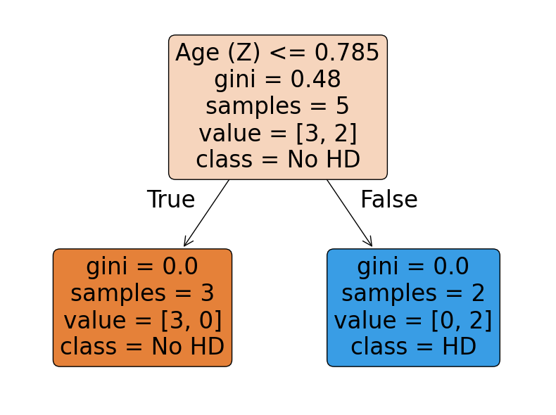
Decision Tree Implementation
A new data point (-0.79, 0.15, -0.67) was fed into the tree.
Based on the Age (Z) split at the root, the data point followed the left branch (Age ≤ 0.785) and was classified as 'No Heart Disease' (0).

Slide 58
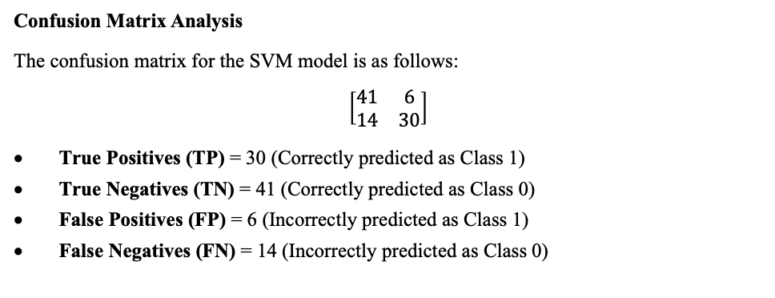
Result Discussion
Confusion Matrix Analysis
The confusion matrix for the SVM model is as follows:
$$\left[\begin{matrix}41 & 6 \\ 14 & 30\end{matrix}\right]$$
True Positives (TP) = 30 (Correctly predicted as Class 1)
True Negatives (TN) = 41 (Correctly predicted as Class 0)
False Positives (FP) = 6 (Incorrectly predicted as Class 1)
False Negatives (FN) = 14 (Incorrectly predicted as Class 0)

Slide 59
Result Discussion
Classification Report
Class | Precision | Recall | F1-Score
0 | 75% | 87% | 80%
1 | 83% | 68% | 75%
Accuracy | 78% | 78% | 78%
Accuracy: 78 %

Slide 60
Random Forest Algorithm
Random Forest is a powerful supervised ensemble learning algorithm that is commonly used for both classification tasks
Random Forest overcomes the limitations of a single decision tree, by constructing an entire "forest"
Each of these trees is trained on a different random subset of the training data, and at every split in a tree, only a random subset of features is considered for decision making.
Social networks

Slide 61
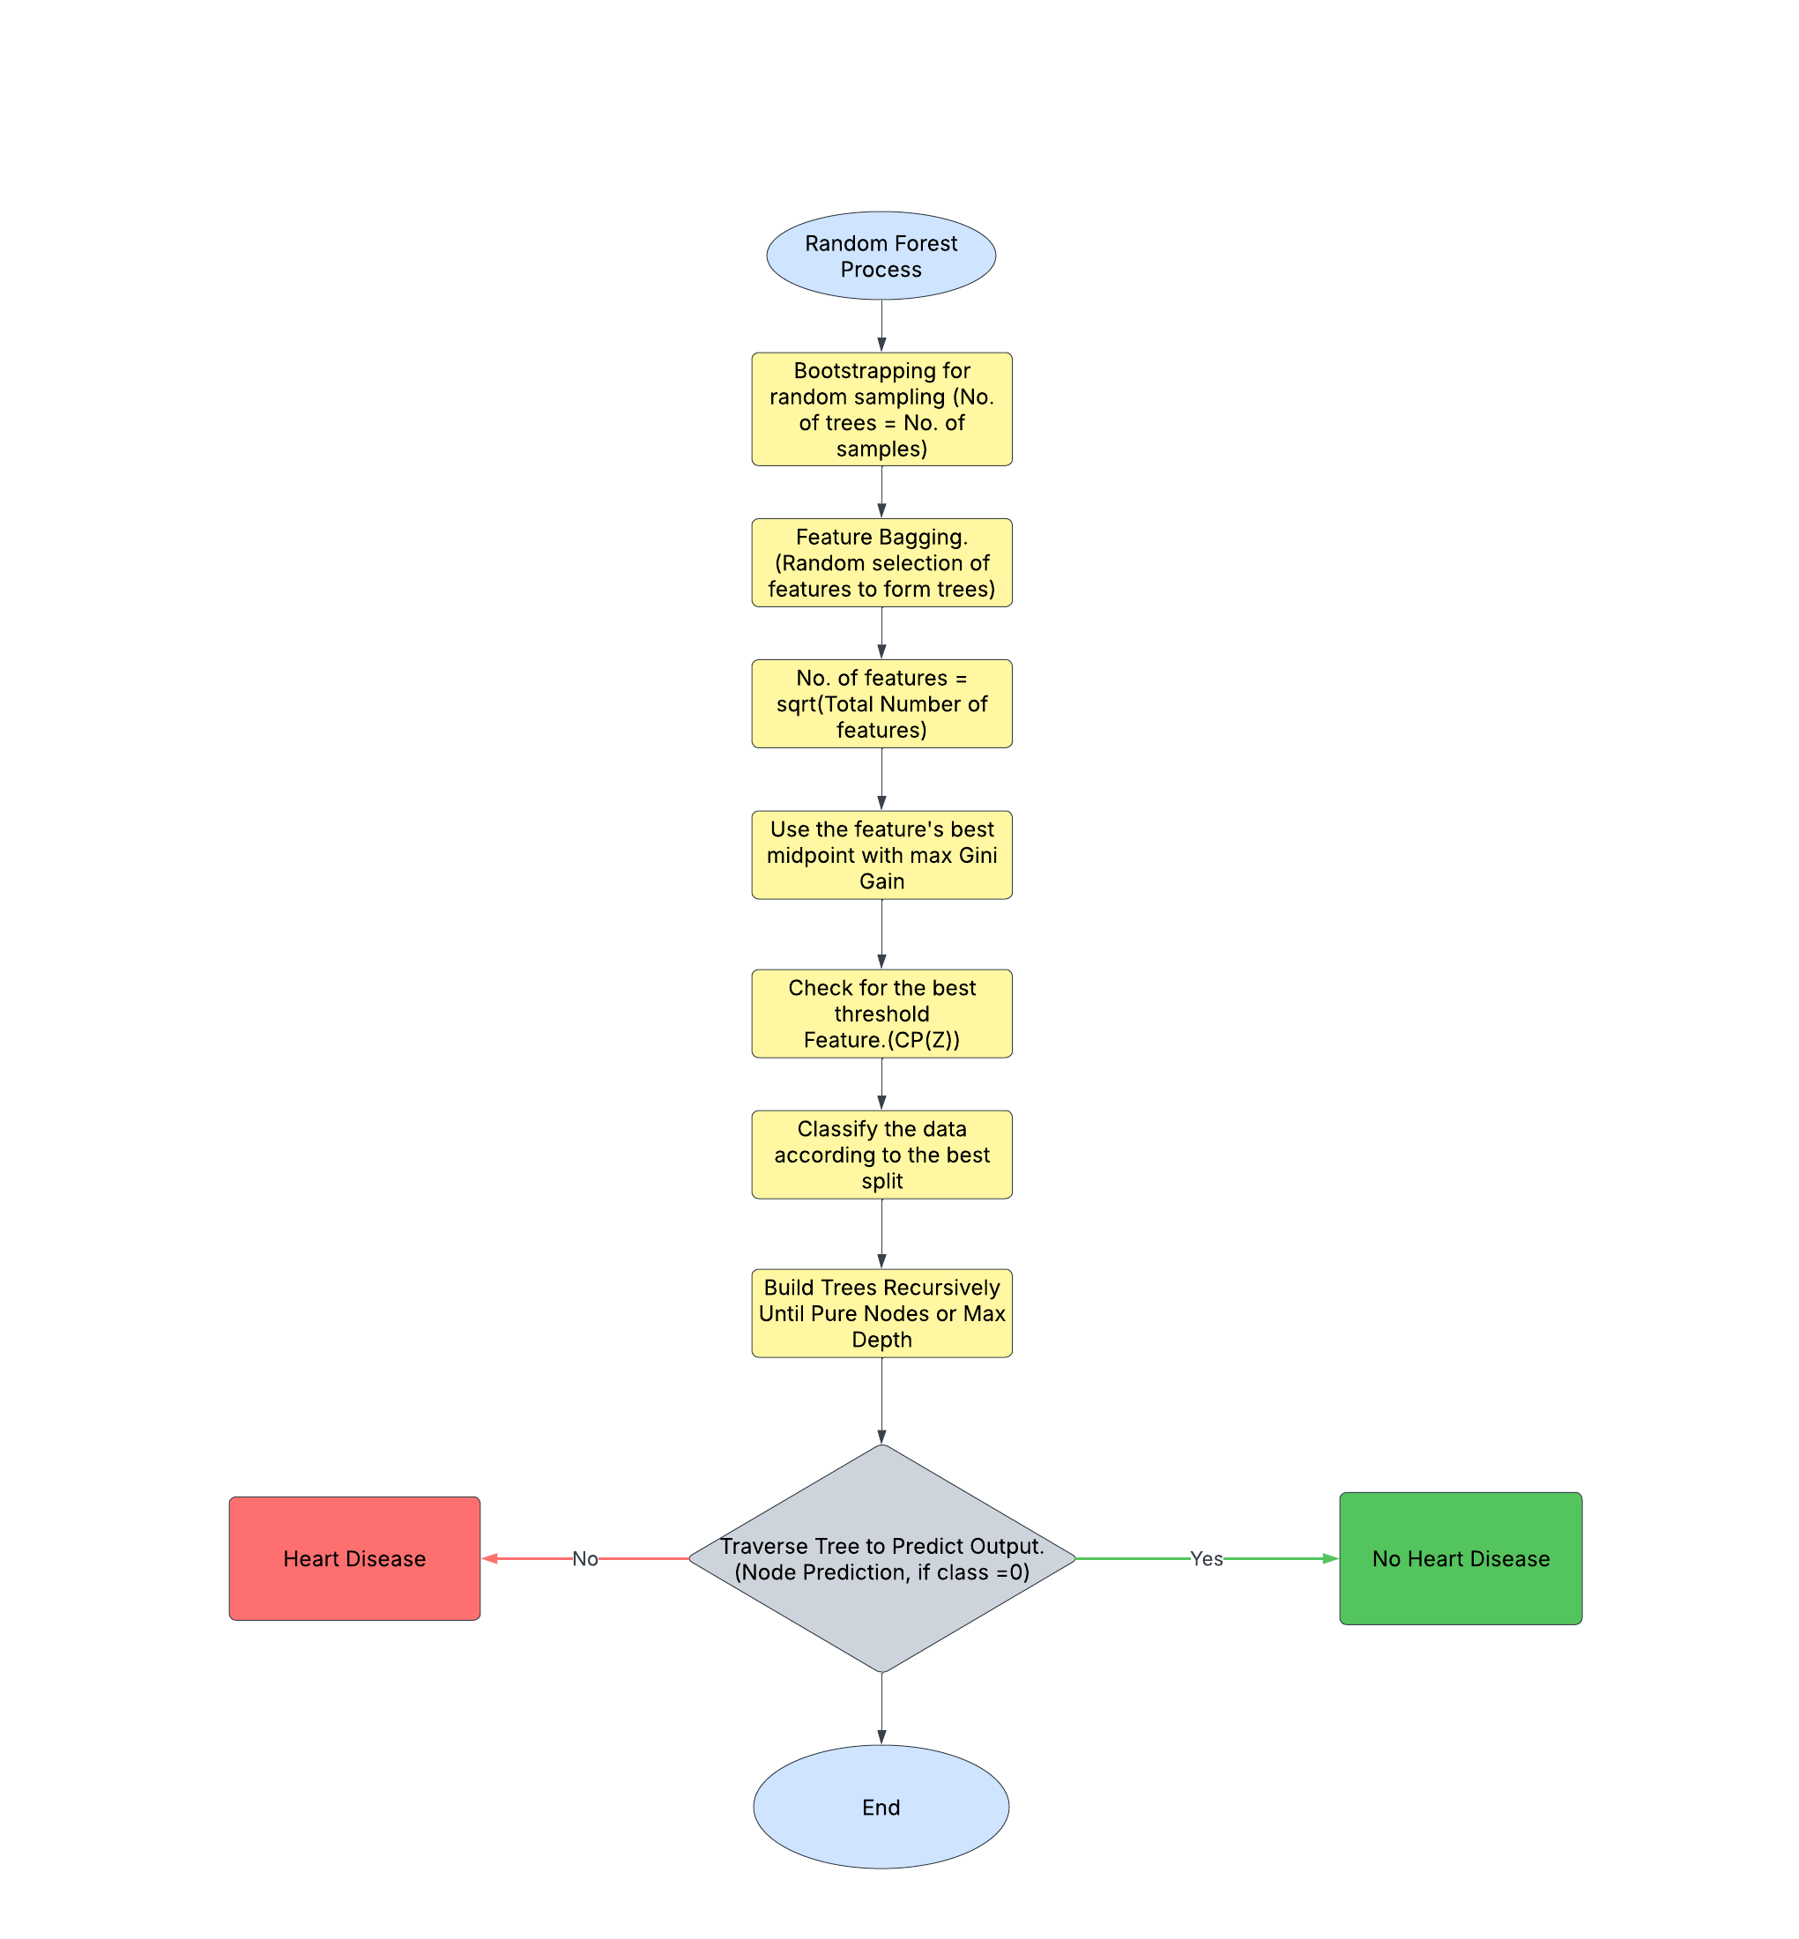
Random Forest Implementation

Slide 62
Random Forest Implementation
Step 1: Bootstrapping the Data (Creating Diverse Training Sets)
The first step in how a Random Forest works is called bootstrapping, which is a technique for creating diverse datasets from the original training data.

Slide 63
Random Forest Implementation
Example:
Tree 1 Sample:
Let’s say the randomly chosen indices are:
[1, 3, 1, 4, 2]
So, the data for Tree 1 becomes:
Index | Age (Z) | CP (Z) | Chol (Z) | Label
1 | 0.94 | 0.92 | 1.50 | 1
3 | -1.42 | 0.15 | 0.32 | 0
1 | 0.94 | 0.92 | 1.50 | 1
4 | -1.10 | -0.62 | -1.20 | 0
2 | 0.94 | 0.92 | -0.38 | 1
Row 1 appears twice
Row 0 is not included

Slide 64
Random Forest Implementation
Tree 2 Sample:
Random indices:
[0, 0, 4, 2, 3]
Index | Age (Z) | CP (Z) | Chol (Z) | Label
0 | 0.63 | -1.38 | -0.24 | 0
0 | 0.63 | -1.38 | -0.24 | 0
4 | -1.10 | -0.62 | -1.20 | 0
2 | 0.94 | 0.92 | -0.38 | 1
3 | -1.42 | 0.15 | 0.32 | 0
Row 0 appears twice
Row 1 is missing
Each tree learns from a slightly different dataset, introducing natural randomness.

Slide 65
Random Forest Implementation
Step 2: Random Feature Selection (Feature Bagging)
When building a decision tree, the expectation is to look at all the features at each node to decide the best way to split the data.
But in a Random Forest, we intentionally restrict each tree to look at only a random subset of features at each split.

Slide 66
Random Forest Implementation
Example:
Using 3 features:
Age (Z)
CP (Z)
Chol (Z)
When the algorithm reaches a node in one of the decision trees, it might do something like this:
How Many Features Are Selected?
That depends on whether it's a classification or regression task:
Task | Common Practice
Classification | √p (square root of total features)
Regression | p/3 (one-third of total features)
In this case, with 3 features:
For classification: √3 ≈ 1 or 2 features randomly chosen at each node

Slide 67
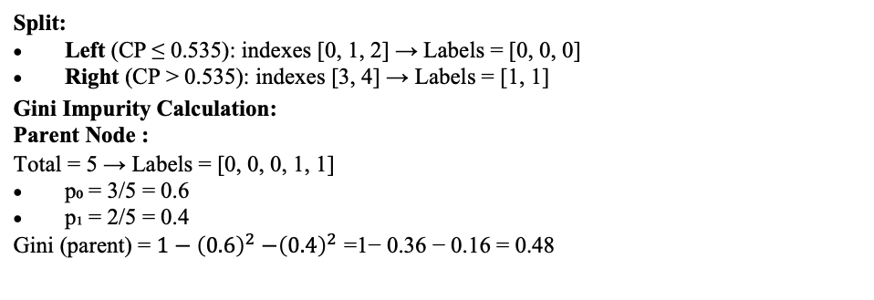
Random Forest Implementation
Scenario 1(Node in Tree 1):
Randomly picks: [CP (Z), Chol (Z)]
It ignores Age (Z) at this node.
Sorted CP(Z) values with labels:
CP (Z) | Label
-1.38 | 0
-0.62 | 0
0.15 | 0
0.92 | 1
0.92 | 1
We calculate midpoints between adjacent sorted and unique values to use as candidate thresholds:
T₁ = (-1.38 + -0.62) / 2 = -1.00
T₂ = (-0.62 + 0.15) / 2 = -0.235
T₃ = (0.15 + 0.92) / 2 = 0.535
Split at Threshold T₃ = 0.535:
Split:
Left (CP ≤ 0.535): indexes [0, 1, 2] → Labels = [0, 0, 0]
Right (CP > 0.535): indexes [3, 4] → Labels = [1, 1]
Gini Impurity Calculation:
Parent Node :
Total = 5 → Labels = [0, 0, 0, 1, 1]
p₀ = 3/5 = 0.6
p₁ = 2/5 = 0.4
Gini (parent)​ = $1−{\left(0.6\right)}^{2}{−\left(0.4\right)}^{2}$ =1− 0.36 − 0.16 = 0.48

Slide 68
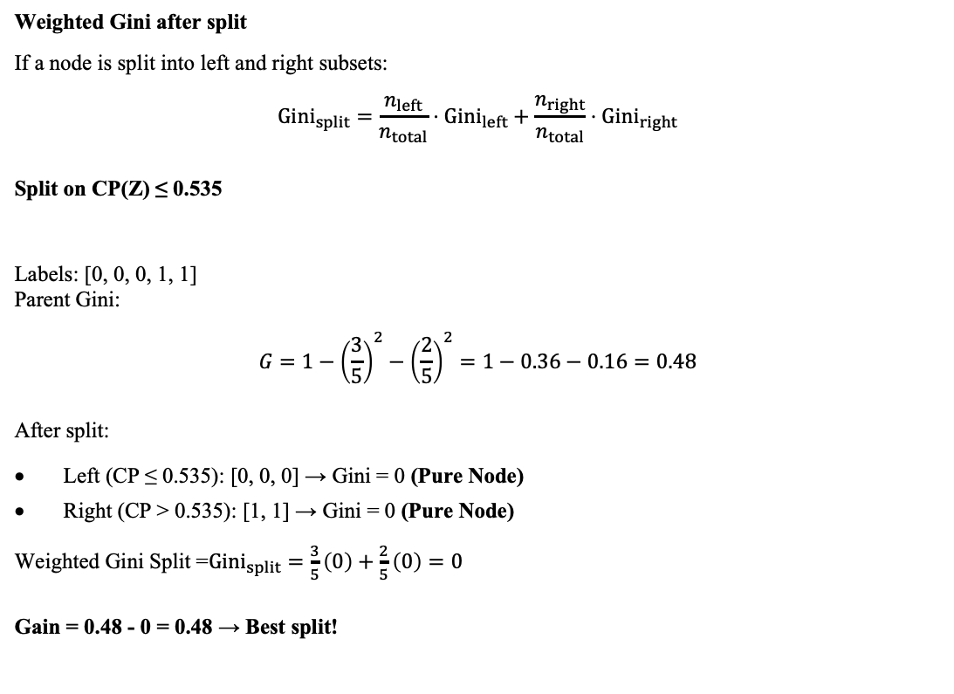
Random Forest Implementation
Weighted Gini after split
If a node is split into left and right subsets:
$${Gini}_{split}=\frac{n_{left}}{n_{total}}⋅{Gini}_{left}+\frac{n_{right}}{n_{total}}⋅{Gini}_{right}$$
Split on CP(Z) ≤ 0.535
Labels: [0, 0, 0, 1, 1] Parent Gini:
$$G=1−{\left(\frac{3}{5}\right)}^{2}−{\left(\frac{2}{5}\right)}^{2}=1−0.36−0.16=0.48$$
After split:
Left (CP ≤ 0.535): [0, 0, 0] → Gini = 0 (Pure Node)
Right (CP > 0.535): [1, 1] → Gini = 0 (Pure Node)
Weighted Gini Split =${Gini}_{split}=\frac{3}{5}\left(0\right)+\frac{2}{5}\left(0\right)=0$
Gain = 0.48 - 0 = 0.48 → Best split!

Slide 69
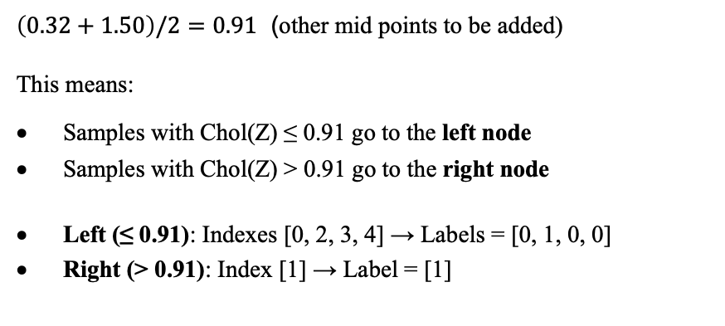
Random Forest Implementation
Evaluating Chol (Z)
Chol (Z) | Label
-1.20 | 0
-0.38 | 1
-0.24 | 0
0.32 | 0
1.50 | 1
$\left(0.32+1.50\right)/2=0.91$ (other mid points to be added)
This means:
Samples with Chol(Z) ≤ 0.91 go to the left node
Samples with Chol(Z) > 0.91 go to the right node
Left (≤ 0.91): Indexes [0, 2, 3, 4] → Labels = [0, 1, 0, 0]
Right (> 0.91): Index [1] → Label = [1]

Slide 70
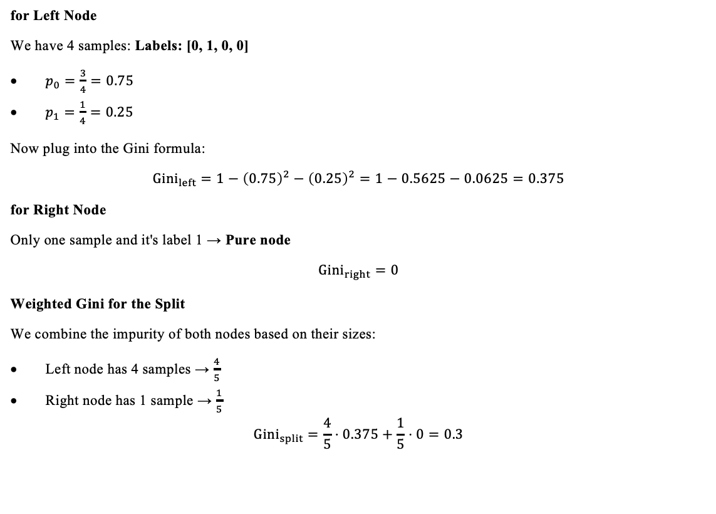
Random Forest Implementation
for Left Node
We have 4 samples: Labels: [0, 1, 0, 0]
$p_{0}=\frac{3}{4}=0.75$
$p_{1}=\frac{1}{4}=0.25$
Now plug into the Gini formula:
$${Gini}_{left}=1−{\left(0.75\right)}^{2}−{\left(0.25\right)}^{2}=1−0.5625−0.0625=0.375$$
for Right Node
Only one sample and it's label 1 → Pure node
$${Gini}_{right}=0$$
Weighted Gini for the Split
We combine the impurity of both nodes based on their sizes:
Left node has 4 samples → $\frac{4}{5}$
Right node has 1 sample → $\frac{1}{5}$
$${Gini}_{split}=\frac{4}{5}⋅0.375+\frac{1}{5}⋅0=0.3$$

Slide 71
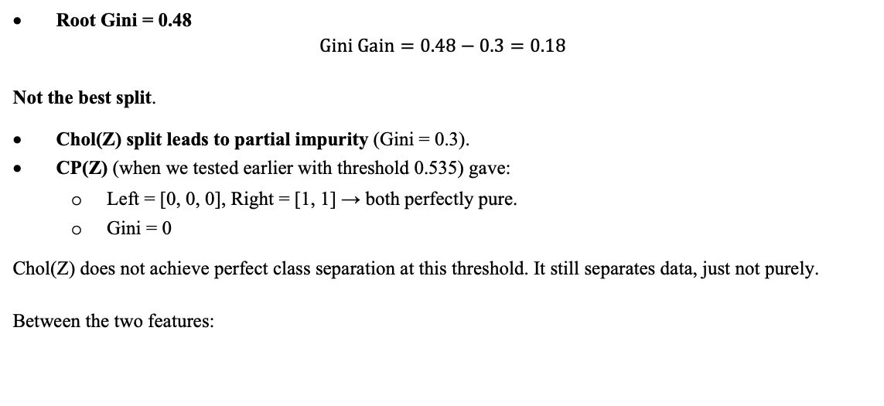
Random Forest Implementation
Root Gini = 0.48
$$Gini Gain=0.48−0.3=0.18$$
Not the best split.
Chol(Z) split leads to partial impurity (Gini = 0.3).
CP(Z) (when we tested earlier with threshold 0.535) gave:
Left = [0, 0, 0], Right = [1, 1] → both perfectly pure.
Gini = 0
Chol(Z) does not achieve perfect class separation at this threshold. It still separates data, just not purely.
Between the two features:
Feature | Threshold | Weighted Gini (impurity) | Gini Gain
CP (Z) | 0.535 | 0.000 | 0.48
Chol (Z) | 0.91 | 0.300 | 0.18
So, CP(Z) gives the best (purest) split → It is selected at this node.

Slide 72
Random Forest Implementation
New Data Point
Age (Z) = -0.79
CP (Z) = 0.15
Chol (Z) = -0.67
From the previously computed best split at the root of Tree 1:
Feature chosen: CP (Z)
Threshold: 0.535
Split logic:
If CP (Z) ≤ 0.535 → go left
If CP (Z) > 0.535 → go right
Navigating the Tree
The new sample’s CP (Z) value:
CP (Z) = 0.15
Since 0.15 ≤ 0.535, the new data point follows the left branch.

Slide 73
Random Forest Implementation
Left Leaf Node Details
The left branch contains the following training samples
Index | Label
0 | 0
3 | 0
4 | 0
All samples in this node are of Class 0 (No Heart Disease).
Thus, this is a pure node.
Final Prediction by Tree 1
The new data point reaches a pure leaf node labeled 0.
Tree 1’s prediction: Class 0 (No Heart Disease)

Slide 74
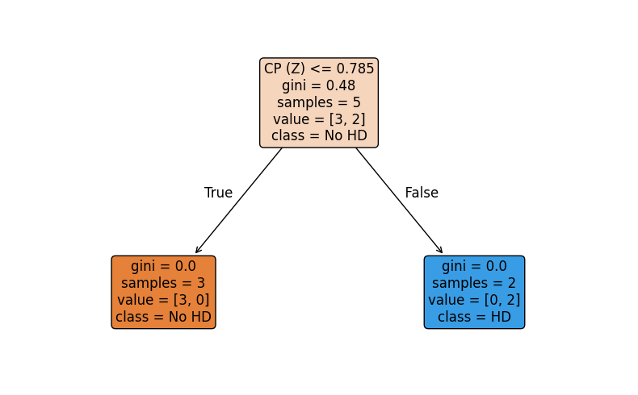
Random Forest Implementation
RF Tree 1

Slide 75
Random Forest Implementation
Scenario 2 (Node in Tree 2):
Randomly picks: [Age (Z), Chol (Z)]
It ignores CP (Z) at this node.
Calculations were made similar to the Scenario 1 and the results:
Chol(Z) split leads to partial impurity (Gini = 0.3).
Age(Z) (when we tested earlier with threshold 0.785) gave:
Left = [0, 0, 0,0], Right = [1] → both perfectly pure.
Gini = 0
Chol(Z) does not achieve perfect class separation at this threshold. It still separates data, just not as cleanly.
Between the two features:
Feature | Threshold | Weighted Gini (impurity) | Gini Gain
Age (Z) | 0.785 | 0.000 | 0.32
Chol (Z) | 0.91 | 0.300 | 0.18
So, Age(Z) gives the best (purest) split → It is selected at this node.

Slide 76
Random Forest Implementation
Final Prediction by Tree 2
The new data point reaches a pure leaf node labeled 0.
Tree 2’s prediction: Class 0 (No Heart Disease)

Slide 77
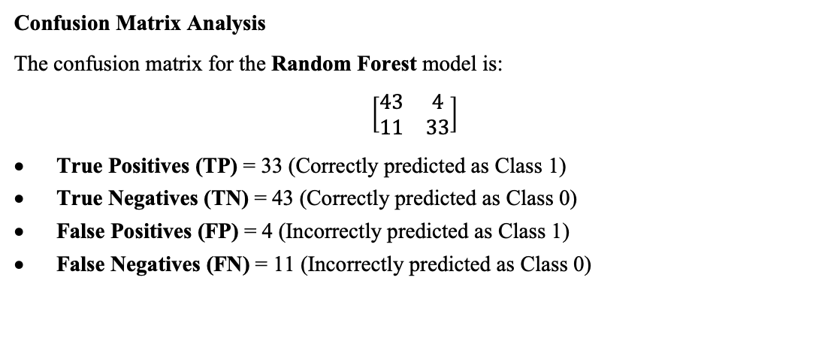
Result Discussion
Confusion Matrix Analysis
The confusion matrix for the Random Forest model is:
$$\left[\begin{matrix}43 & 4 \\ 11 & 33\end{matrix}\right]$$
True Positives (TP) = 33 (Correctly predicted as Class 1)
True Negatives (TN) = 43 (Correctly predicted as Class 0)
False Positives (FP) = 4 (Incorrectly predicted as Class 1)
False Negatives (FN) = 11 (Incorrectly predicted as Class 0)

Slide 78
Result Discussion
Classification Report
Class | Precision | Recall | F1-Score
0 | 80% | 91% | 85%
1 | 89% | 75% | 81%
Accuracy | 84% | 84% | 84%
Accuracy = 0.84 = 84%

Slide 79
Result: Machine Learning Model Performance (Training)
Model | Accuracy | Precision (Class 0) | Precision (Class 1) | Recall (Class 0) | Recall (Class 1)
K-Nearest Neighbors (KNN) | 84.19% | 83% | 86% | 86% | 82%
Logistic Regression | 85.04% | 83% | 87% | 88% | 82%
Support Vector Machine (SVM) | 94.02% | 93% | 96% | 96% | 92%
Decision Tree | 83.33% | 78% | 91% | 93% | 74%
Random Forest | 100.00% | 100% | 100% | 100% | 100%

Slide 80

Result: Machine Learning Model Performance (Testing)
Model | Accuracy | Precision (Class 0) | Precision (Class 1) | Recall (Class 0) | Recall (Class 1)
K-Nearest Neighbors (KNN) | 82.42% | 80% | 85% | 87% | 77%
Logistic Regression | 83.32% | 87% | 85% | 87% | 79%
Support Vector Machine (SVM) | 80.22% | $$78\%$$ | 82% | 85% | 75%
Decision Tree | 78.02% | 87% | 68% | 75% | 83%
Random Forest | 83.52% | 80% | 75% | 91% | 75%

Slide 81
Result: Machine Learning Model Performance
While all models achieved satisfactory results, Logistic Regression and Random Forest consistently outperformed others in terms of overall accuracy and class-wise precision-recall balance. KNN also showed reliable performance, making it a competitive alternative. Decision Tree, though interpretable, may not generalize as well, as seen from its lower accuracy and precision.

Slide 82
Training v/s Testing
Model | Training Accuracy | Testing Accuracy
K-Nearest Neighbors | 84.19% | 82.42%
Logistic Regression | 85.04% | 83.52%
SVM | 93.16% | 80.22%
Decision Tree | 83.33% | 78.02%
Random Forest | 100.00% | 83.52%

Slide 83
Training v/s Testing
The training vs. testing accuracy comparison provides a diagnostic view of each model’s learning behavior. While Logistic Regression and KNN show balanced and reliable performance, SVM and Random Forest demonstrate signs of overfitting, with SVM being more susceptible to generalization loss. The Decision Tree, though interpretable, shows slightly lower testing accuracy, indicating it may be better suited as part of an ensemble rather than a standalone classifier.

Slide 84
Summary and Conclusion
This project proposes a data-driven approach to predict cardiovascular disease (CVD) using machine learning (ML) models integrated with engineering management practices.
Preprocessing: Data cleaning, normalization, and feature engineering ensured consistency and reliability.
ML Models:
Random Forest: Highest training accuracy (100%) but slight overfitting (test accuracy: 84%).
Logistic Regression: Balanced and reliable (train: 85.04%, test: 83.52%).
k-NN: Stable generalization (train: 84.19%, test: 82.42%).
SVM: High train (93.16%) but dropped on test (80.22%) → overfitting.
Decision Tree: Most interpretable, but lowest test accuracy (78.02%).
Logistic Regression and Random Forest are the most effective for CVD prediction.

Slide 85
THANK YOU!

